Slide 1
Southeast Valley Community Alliance
Dedicated to build resilience through, outreach concerning harmful substances and behaviors by empowering the community to make a positive measurable difference in their physical, emotional, and mental health for a brighter future.

Slide 2
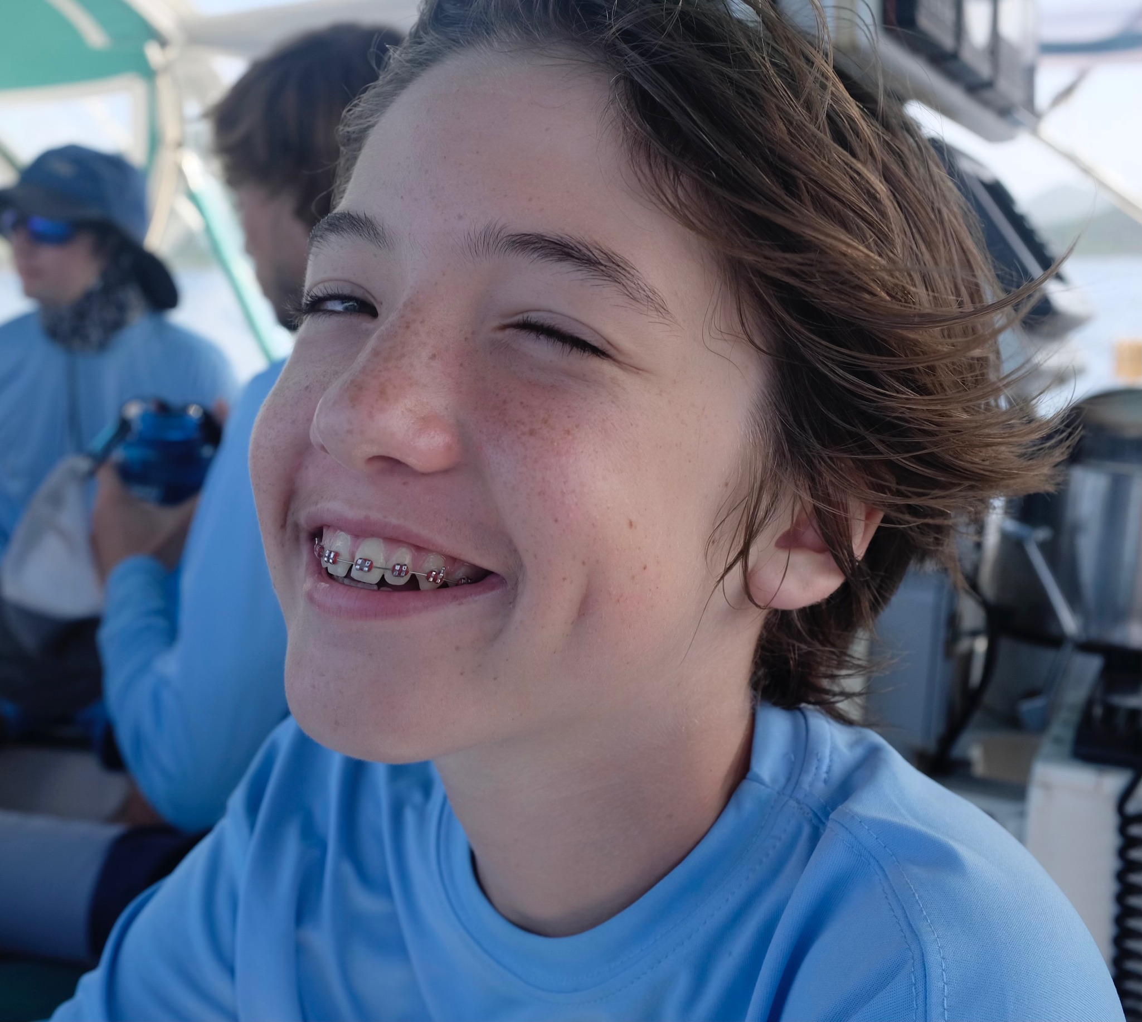
Why
Alexander Neville
14 years old
First born

Slide 3
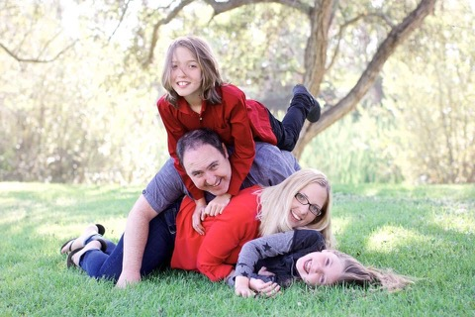
Personal background
Mom of two
Wife
Business manager
Yoga studio
Online yoga

Slide 4
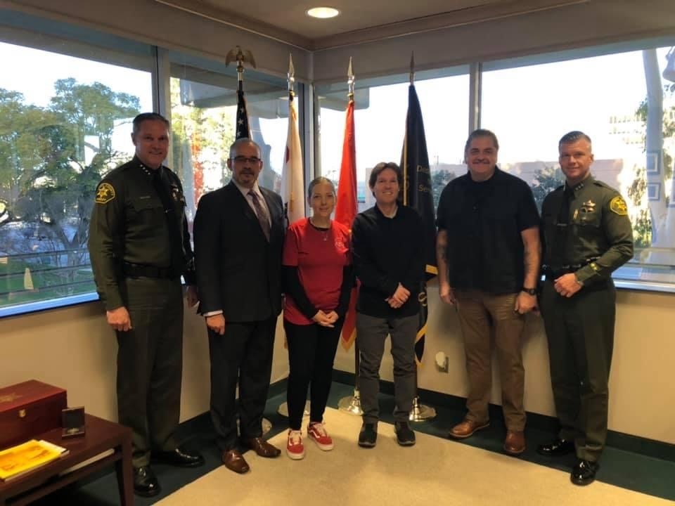
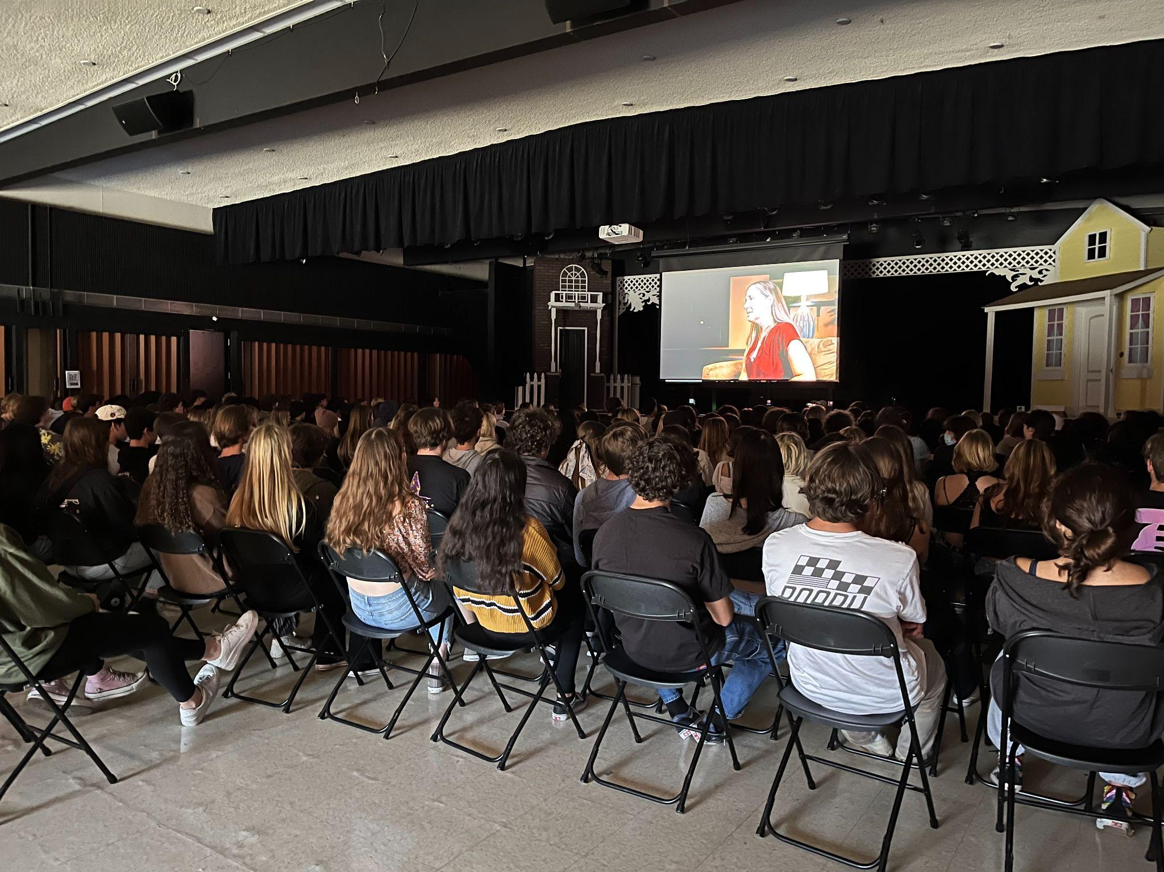
Subsequent Work
Southern California sheriffs
Drug Enforcement Administration
Reporters
Lawmakers
Presentations:
Students
Faculty
School districts: Capo, Riverside, San Bernardino, San Diego
Parents
Organizations

Slide 5
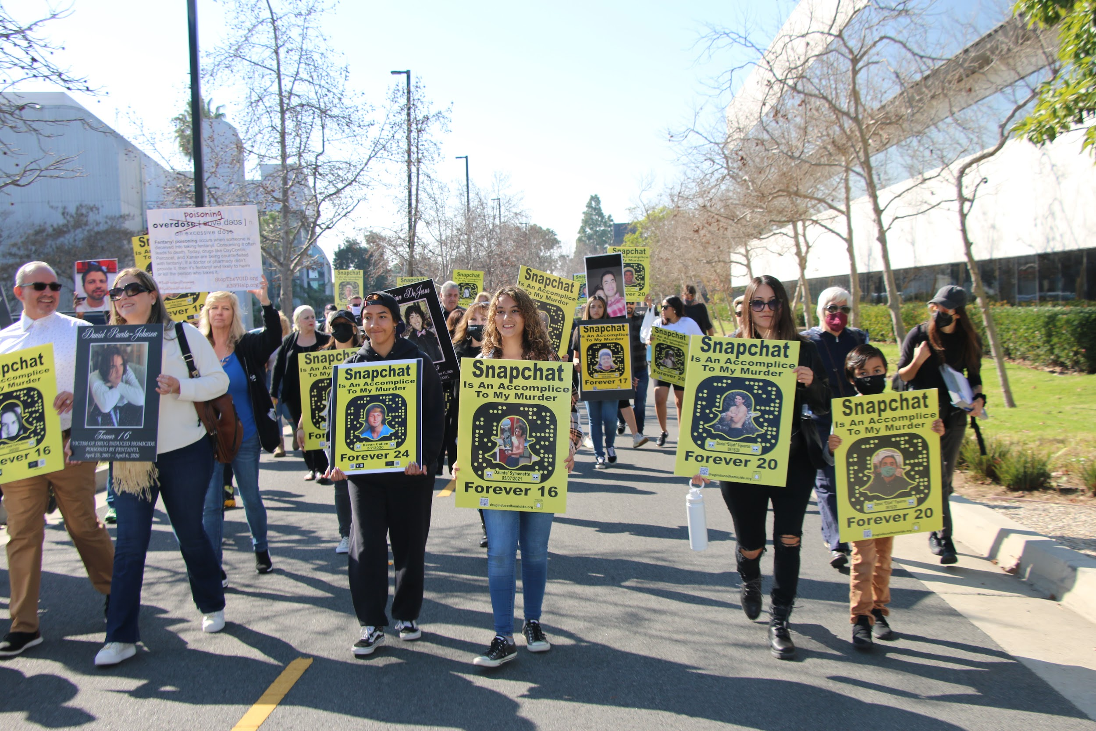
More Work
Public Service Announcements
dead on arrival
OC Sheriff
Scouts
Snapchat
Dialog with directors
NBC News and other outlets
Notorious Markets report
In-person rallies to call attention

Slide 6
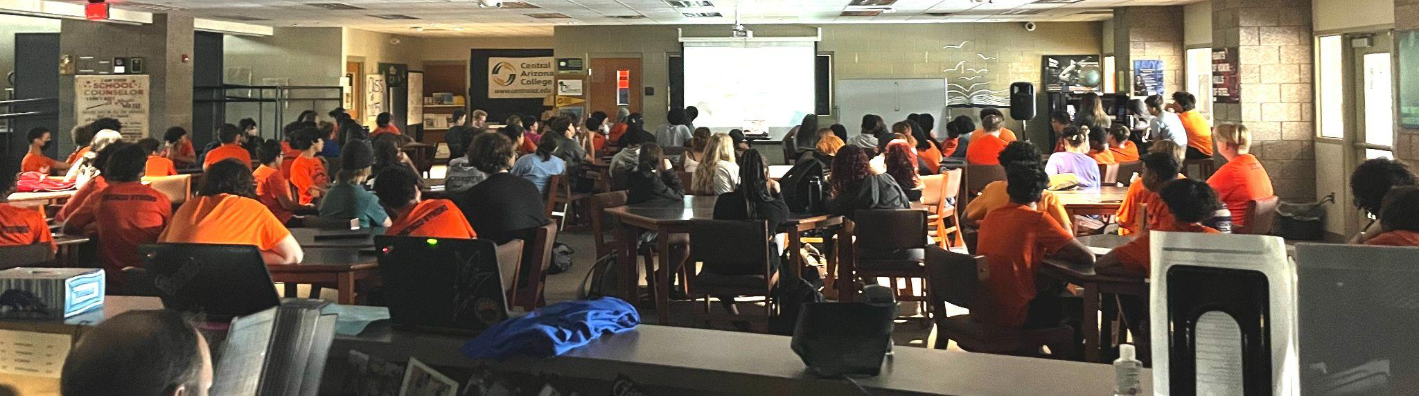
Southeast Valley Community Alliance
Formed in January 2022
Approved funding in March 2022
Drug Take Back event in Queen Creek
High School presentations in FUSD
Community events in Queen Creek

Slide 7


Amy Neville
Southeast Valley Community Alliance
480-213-3705
amy@anfhelp.org
@anfhelp - FB, Insta, Twitter
ANFHelp.org

