Slide 1






2022 Community-based PAX Trainings
for Arizona!
Self-paced Training for
Youth Workers

Slide 2
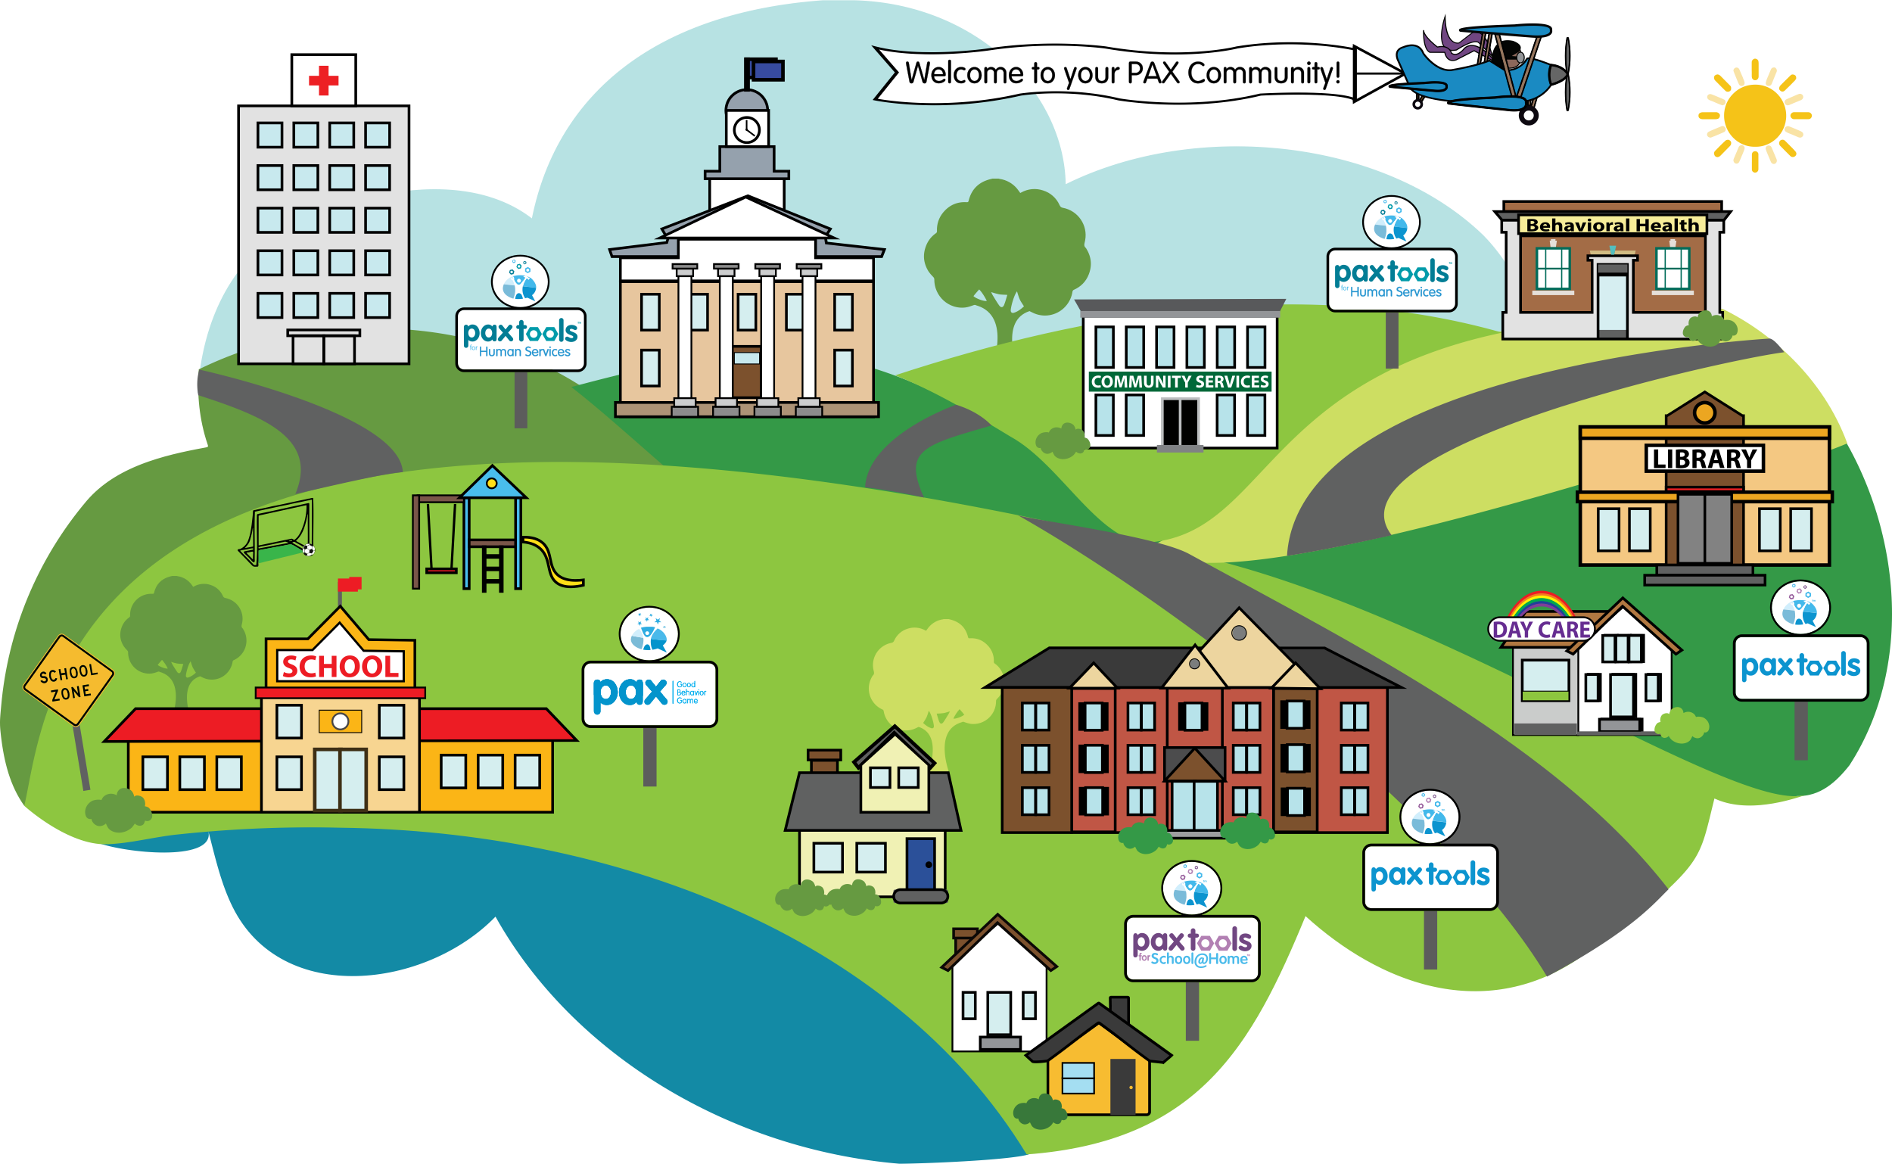
Community-based PAX Trainings for Arizona!
In 2021, PAXIS Institute trained 674 Arizona community-based professionals who work directly with children to implement PAX. These included professionals who work with children outside of school in a number of different fields including: congregate care staff, clinicians, behavioral health technicians, youth workers and more.
Notes:
557 PTHS + 117 Congregate Care

Slide 3
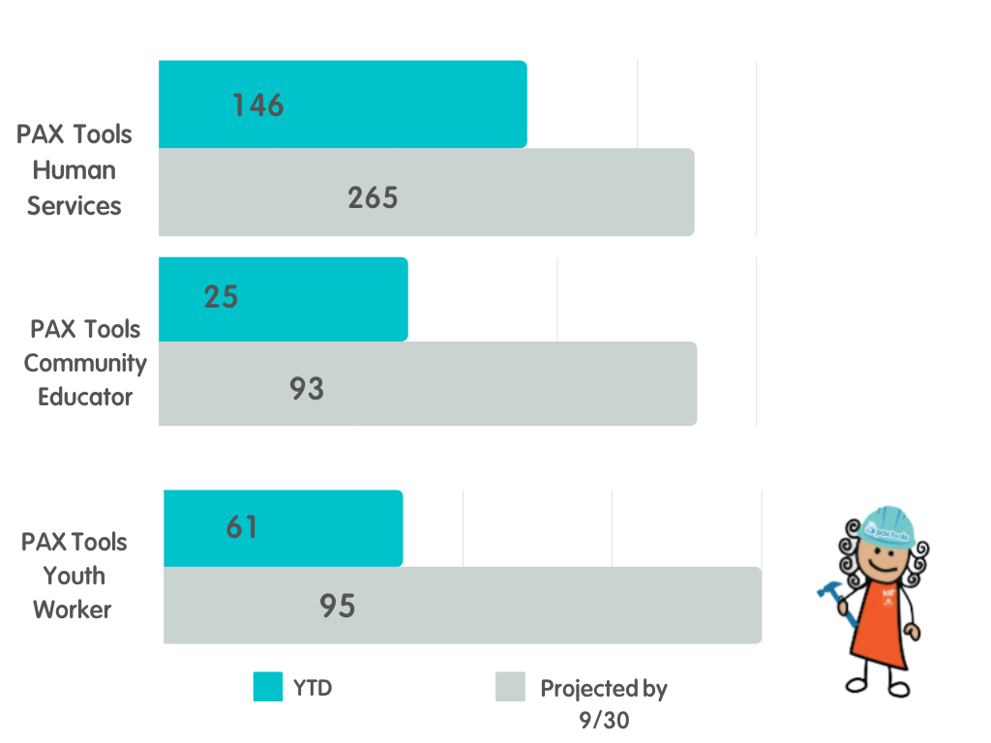
FY 22 AZ PAX Community Professionals Trained
PAX Human Services
- YTD= 146
- Projected by 9/30 = 265
PAX Tools Community Educator
- YTD= 25
- Projected by 9/30 = 93
PAX Tools Youth Worker
- YTD= 61
- Projected by 9/30= 95

Slide 4
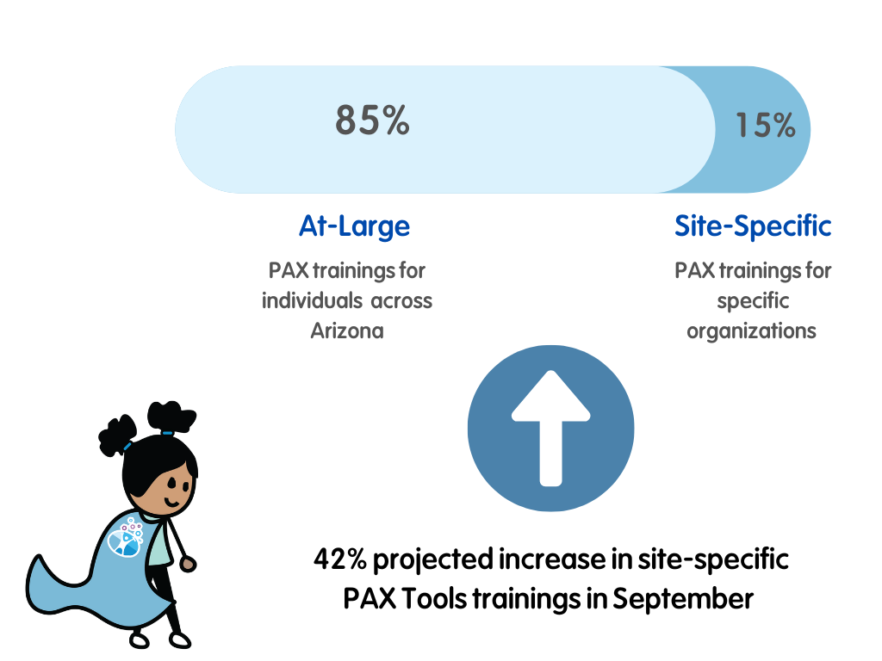
FY 22 AZ PAX Tools Trainings
Site-Specific trainings for:
Touchstone
La Frontera
AZ Boys & Girls Club
Mary’s Mission and Development Center
La Paloma
Pathways
Bayless Healthcare

Slide 5
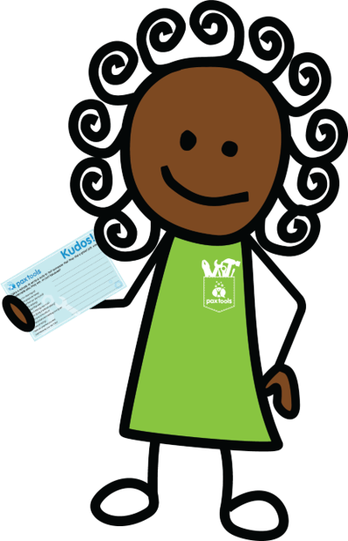
PAX Tools Provide a Unified Approach to Behavior:
Improve Relationships
Reduce Conflict
Reliable & consistent adults
Demonstrate fairness
Develop shared expectations
Establish reasonable limits
Increase Positive Behavior
Reinforce desired behavior
Deliver positive, reinforcing feedback
Teach Behavior as a Skill
Use proven methods
Equip children with strategies to
build skill sets
Practical strategies that can be implemented immediately
Notes:
PAX Good Behavior Game integrates seamlessly with and amplifies the benefits of multiple common school initiatives like PBIS, SEL, Trauma Informed Classrooms, and many more.
PAX GBG provides the recipe to operationalize or teach skills necessary to implement these initiatives.

Slide 6
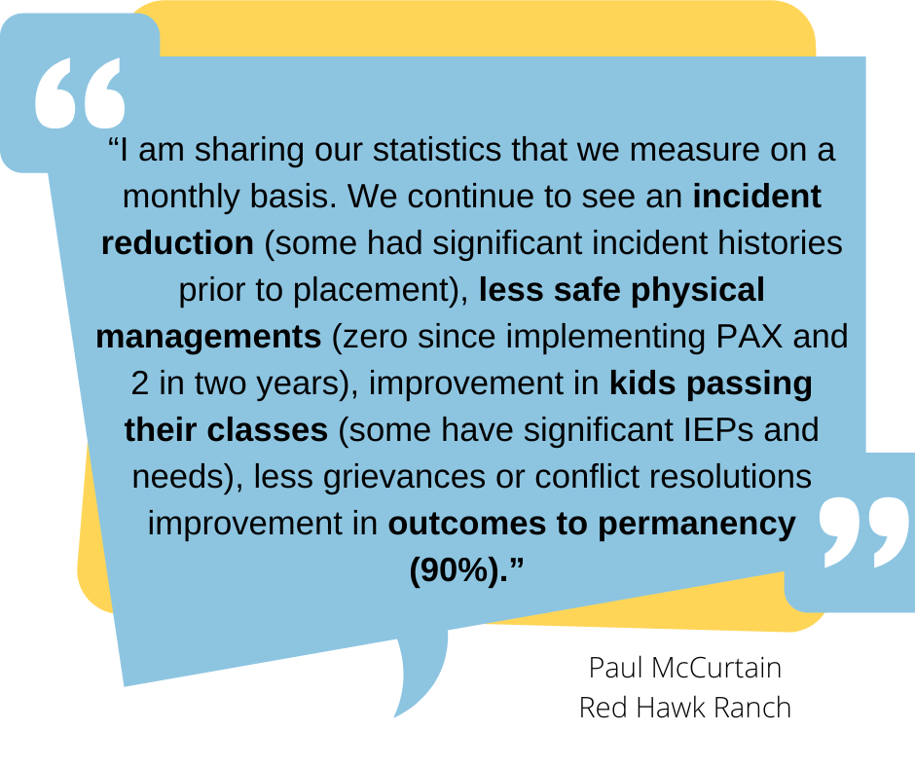

PAX for Red Hawk Ranch
2021 performance indicator report

Slide 7
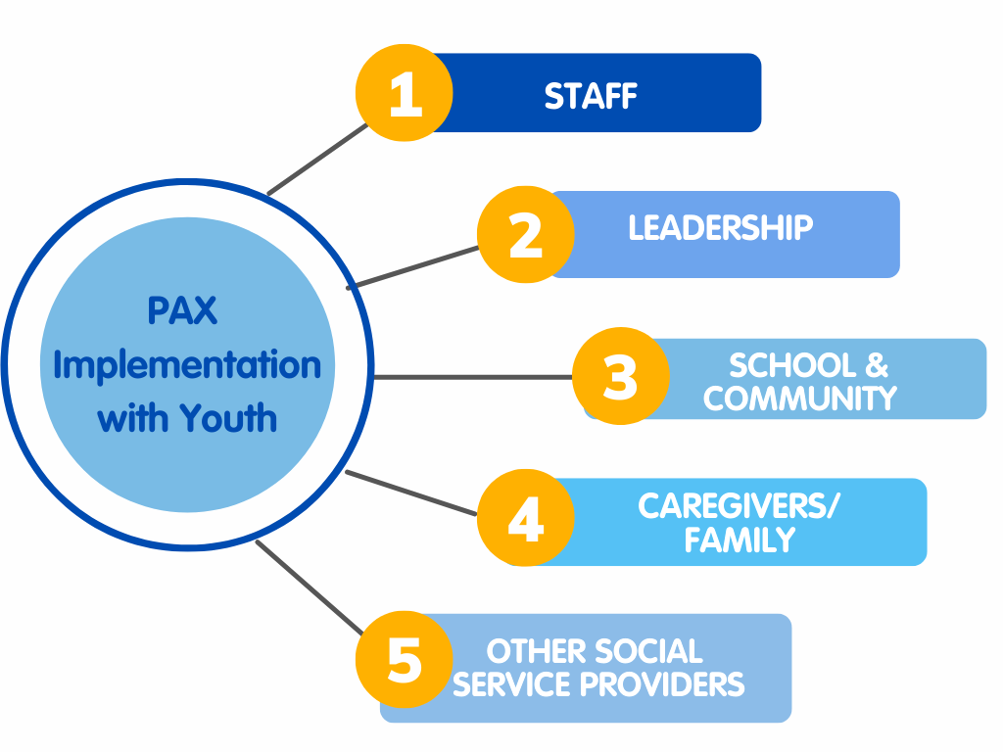
PAX for Red Hawk Ranch
A PAX Journey
Trained management, staff, and kids
Developed a PAX policy for accountability
Made PAX visible and accessible
Teachers & local behavioral health workers were trained in PAX (created common language across settings)
Trained all parents, guardians, kinship, or adoptive families in PAX for transitioning youth
Measured progress (targeted performance indicators)

Slide 8

PAX for Red Hawk Ranch
Reduced critical incidents by 56%
Zero runaways since implementation
Zero physical managements by teaching staff and kids “PAX Breaks”
100% of kids report they feel safe and cared about (monthly surveys)
Increased staff retention
Improved staff skill set in supporting kids with past trauma
Earned 3-year CARF accreditation
2021 performance indicator report

Slide 9
Feedback from Sunshine House
“I thought the training was informative. I think it helps staff see the difference in the kids and that not all kids can be managed the same way”
“This training should help all of our staff stay on the same page which will make for a better working environment”
“I have attended other trauma trainings and I can say I really enjoyed this one the most. I like the idea of getting the kids involved in most of the decision making”
“We have started to use
sticks as a way to lessen arguments about who will shower first, or set the table, or where to sit in the van. The children seem to like this process as they don’t see it as a staff showing favoritism”
“Prior to attending the PAX training, I sometimes struggled with calming behaviors down but the strategies and ideas within PAX has given me a renewed confidence that I can accomplish my goal of maintaining order without shaming the child in the process”

Slide 10


FY 22 AZ Communities Impacted
Apache
Cochise
Coconino
Graham
Gila
Mohave
Navajo
Pima
Pinal
Santa Cruz
Yavapai
Yuma
Apache
Cochise
Coconino
La Paz
Mohave
Navajo
Pima
Pinal
Santa Cruz
Yavapai
Yuma

Slide 11

2021- 2022 PAX AZ
Behavioral Health
Professionals
Touchstone
A New Leaf
Southwest Key
Casa de los Ninos
Mohave Mental Health
Cope Community Services
La Frontera
Bayless Health
Easterseals Blake
Jewish Family Services

Slide 12

2021- 2022 PAX AZ
Youth-Serving Professionals
Boys & Girls Clubs
Southwest Key
A New Leaf
Child & Family Support Services
Easterseals Blake
Ry Services
Touchstone
Casa de los Ninos
Cope Community Services

Slide 13

2021- 2022 PAX AZ
Out of Home Placement Organizations
Sunshine House
Red Hawk Ranch
Mary’s Mission & Development Center
La Paloma
Casa de los Ninos
La Frontera
Jewish Family Services
RY Services

Slide 14
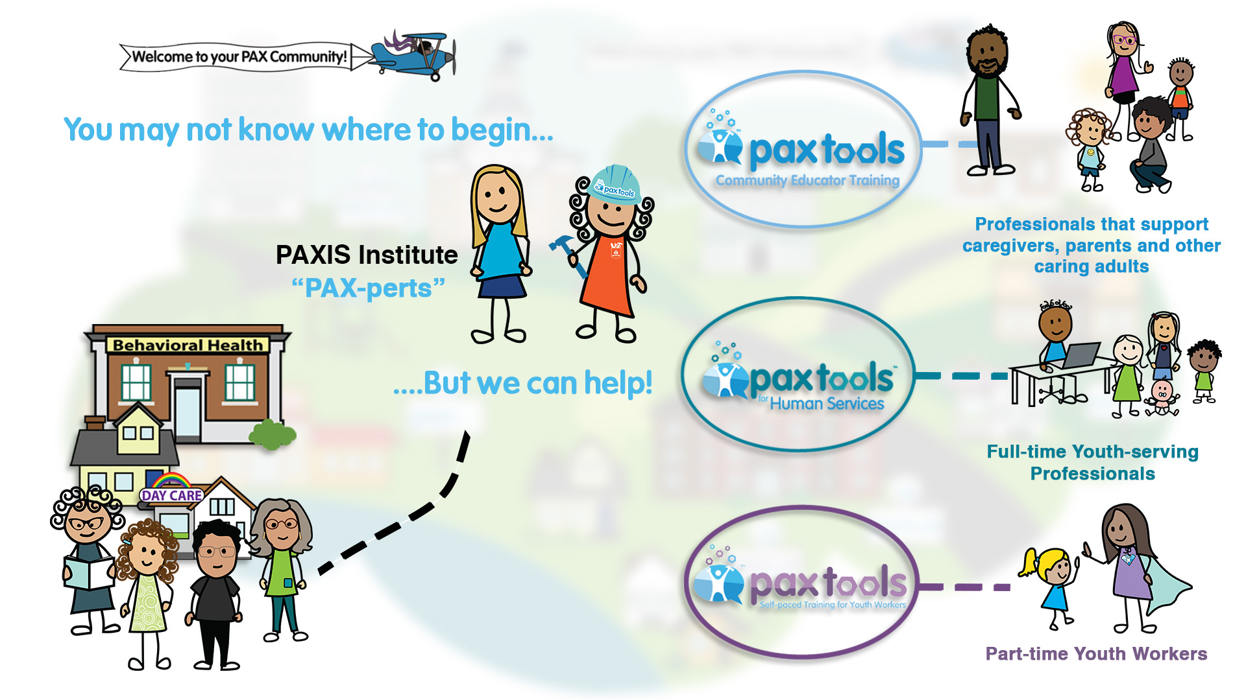
Collaborative Planning for Your Organization

Slide 15
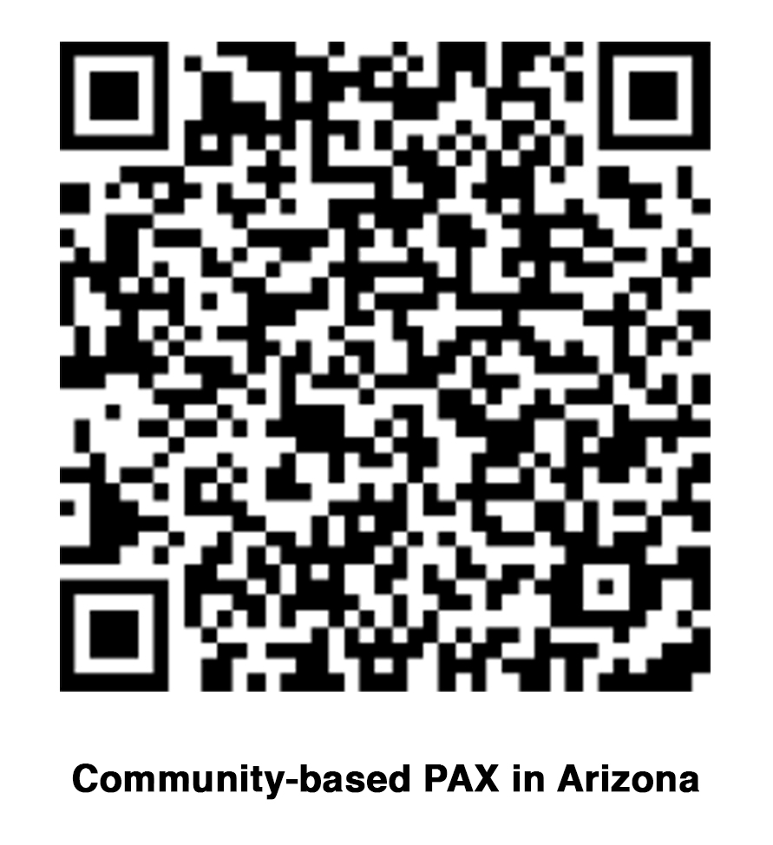
2022 Community-based PAX Trainings
for Arizona!
Want More Info?
Self-paced Training for
Youth Workers
Email: paxarizona@paxis.org

