Slide 1


Help for Today
Hope for Tomorrow
Hope Women’s Center is a trauma-informed center that engages, encourages, and equips women and teen girls facing difficult life situations.
Hope’s holistic approach addresses the physical, emotional, and spiritual needs of a woman.

Slide 2
Hope’s Mission
We engage women and teen girls in viewing themselves through the lens of true worth and value.
We encourage them in healing from abuse, trauma, and loss.
We equip them with tools for making positive choices and breaking unhealthy cycles.

Slide 3
Hope’s History and Community Footprint
Our 501(c)3 began as an East Valley pregnancy center in 1984.
Now we have 6 locations: Phoenix, Apache Junction, Coolidge, West Valley, Maricopa, and Camp Verde. We also have a maternity home in Camp Verde.

Slide 4
Hope’s Dedication
to Trauma
Informed Care
Hope is a safe place where personal perspective and choice are respected, trusting relationships are built, and community encourages the resiliency and strength of each woman.
We also use the language of ProGrace in working with women facing unplanned pregnancies, as we believe this more fully expresses our commitment to the well being of both mother and baby.

Slide 5
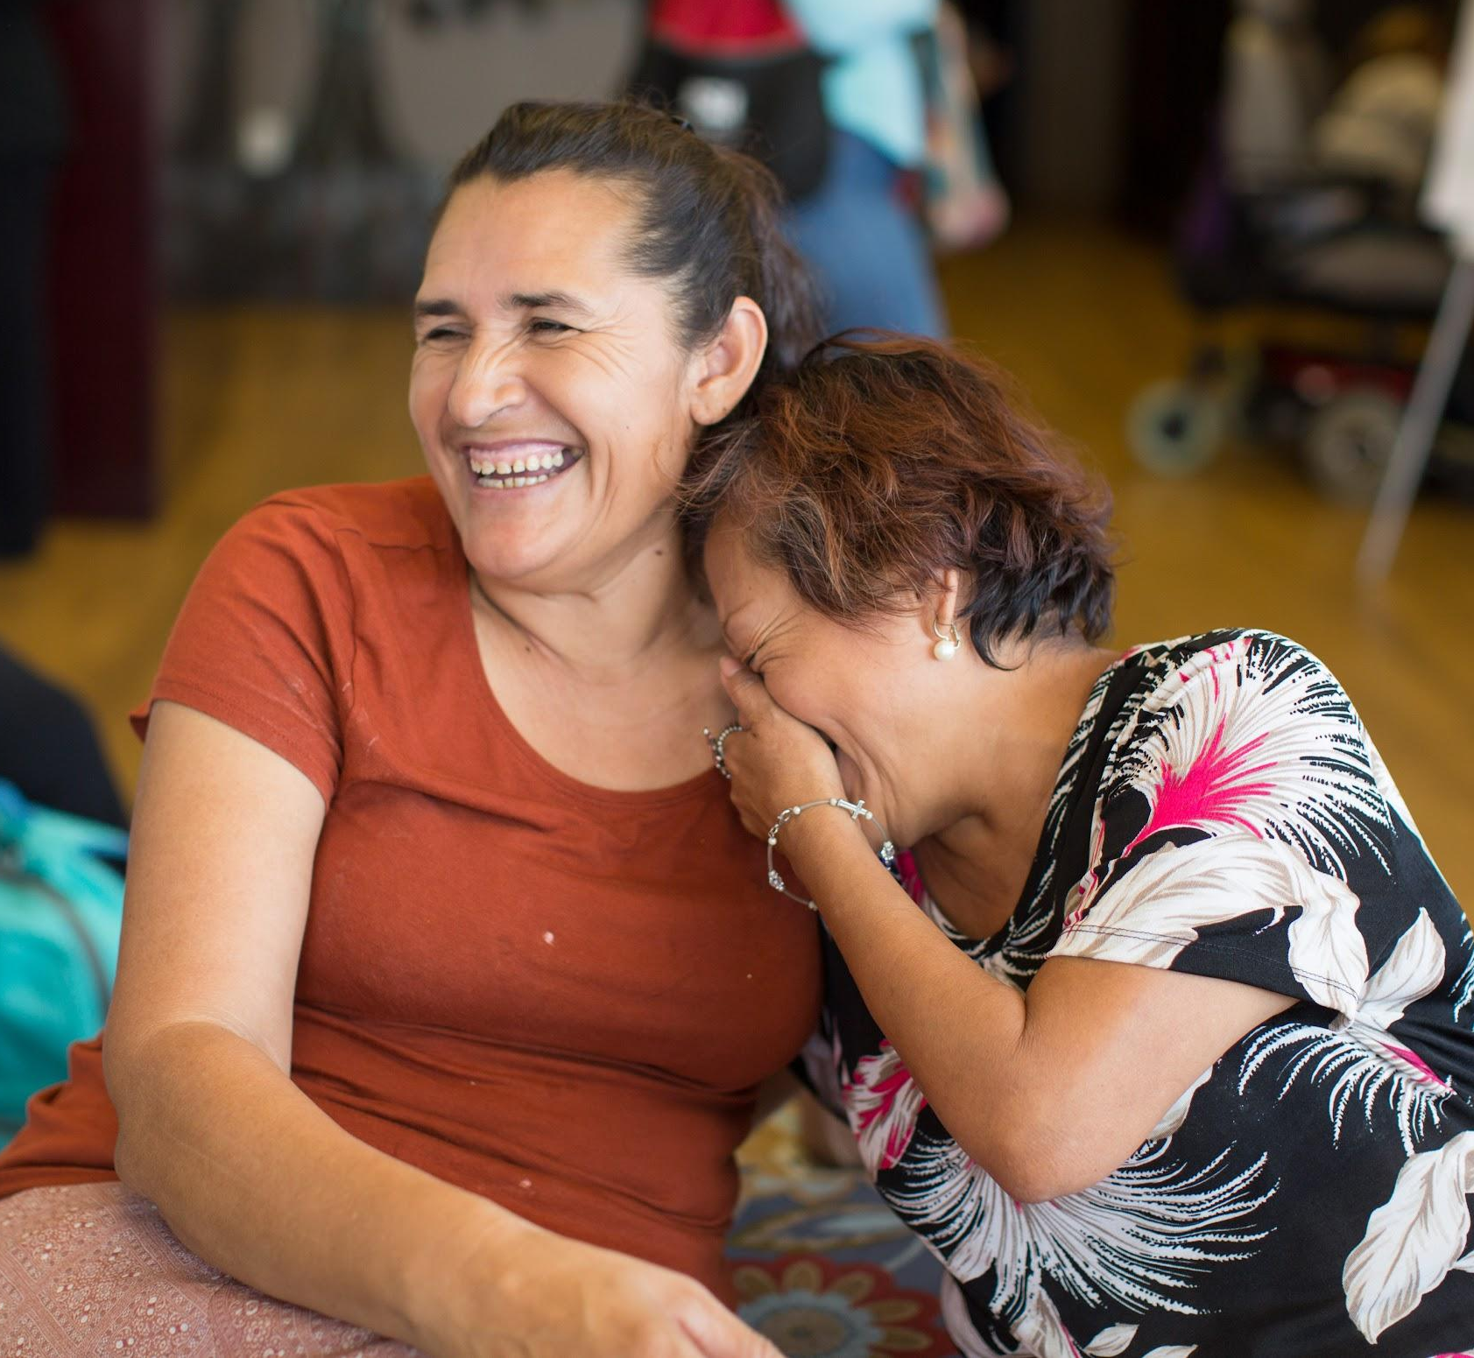
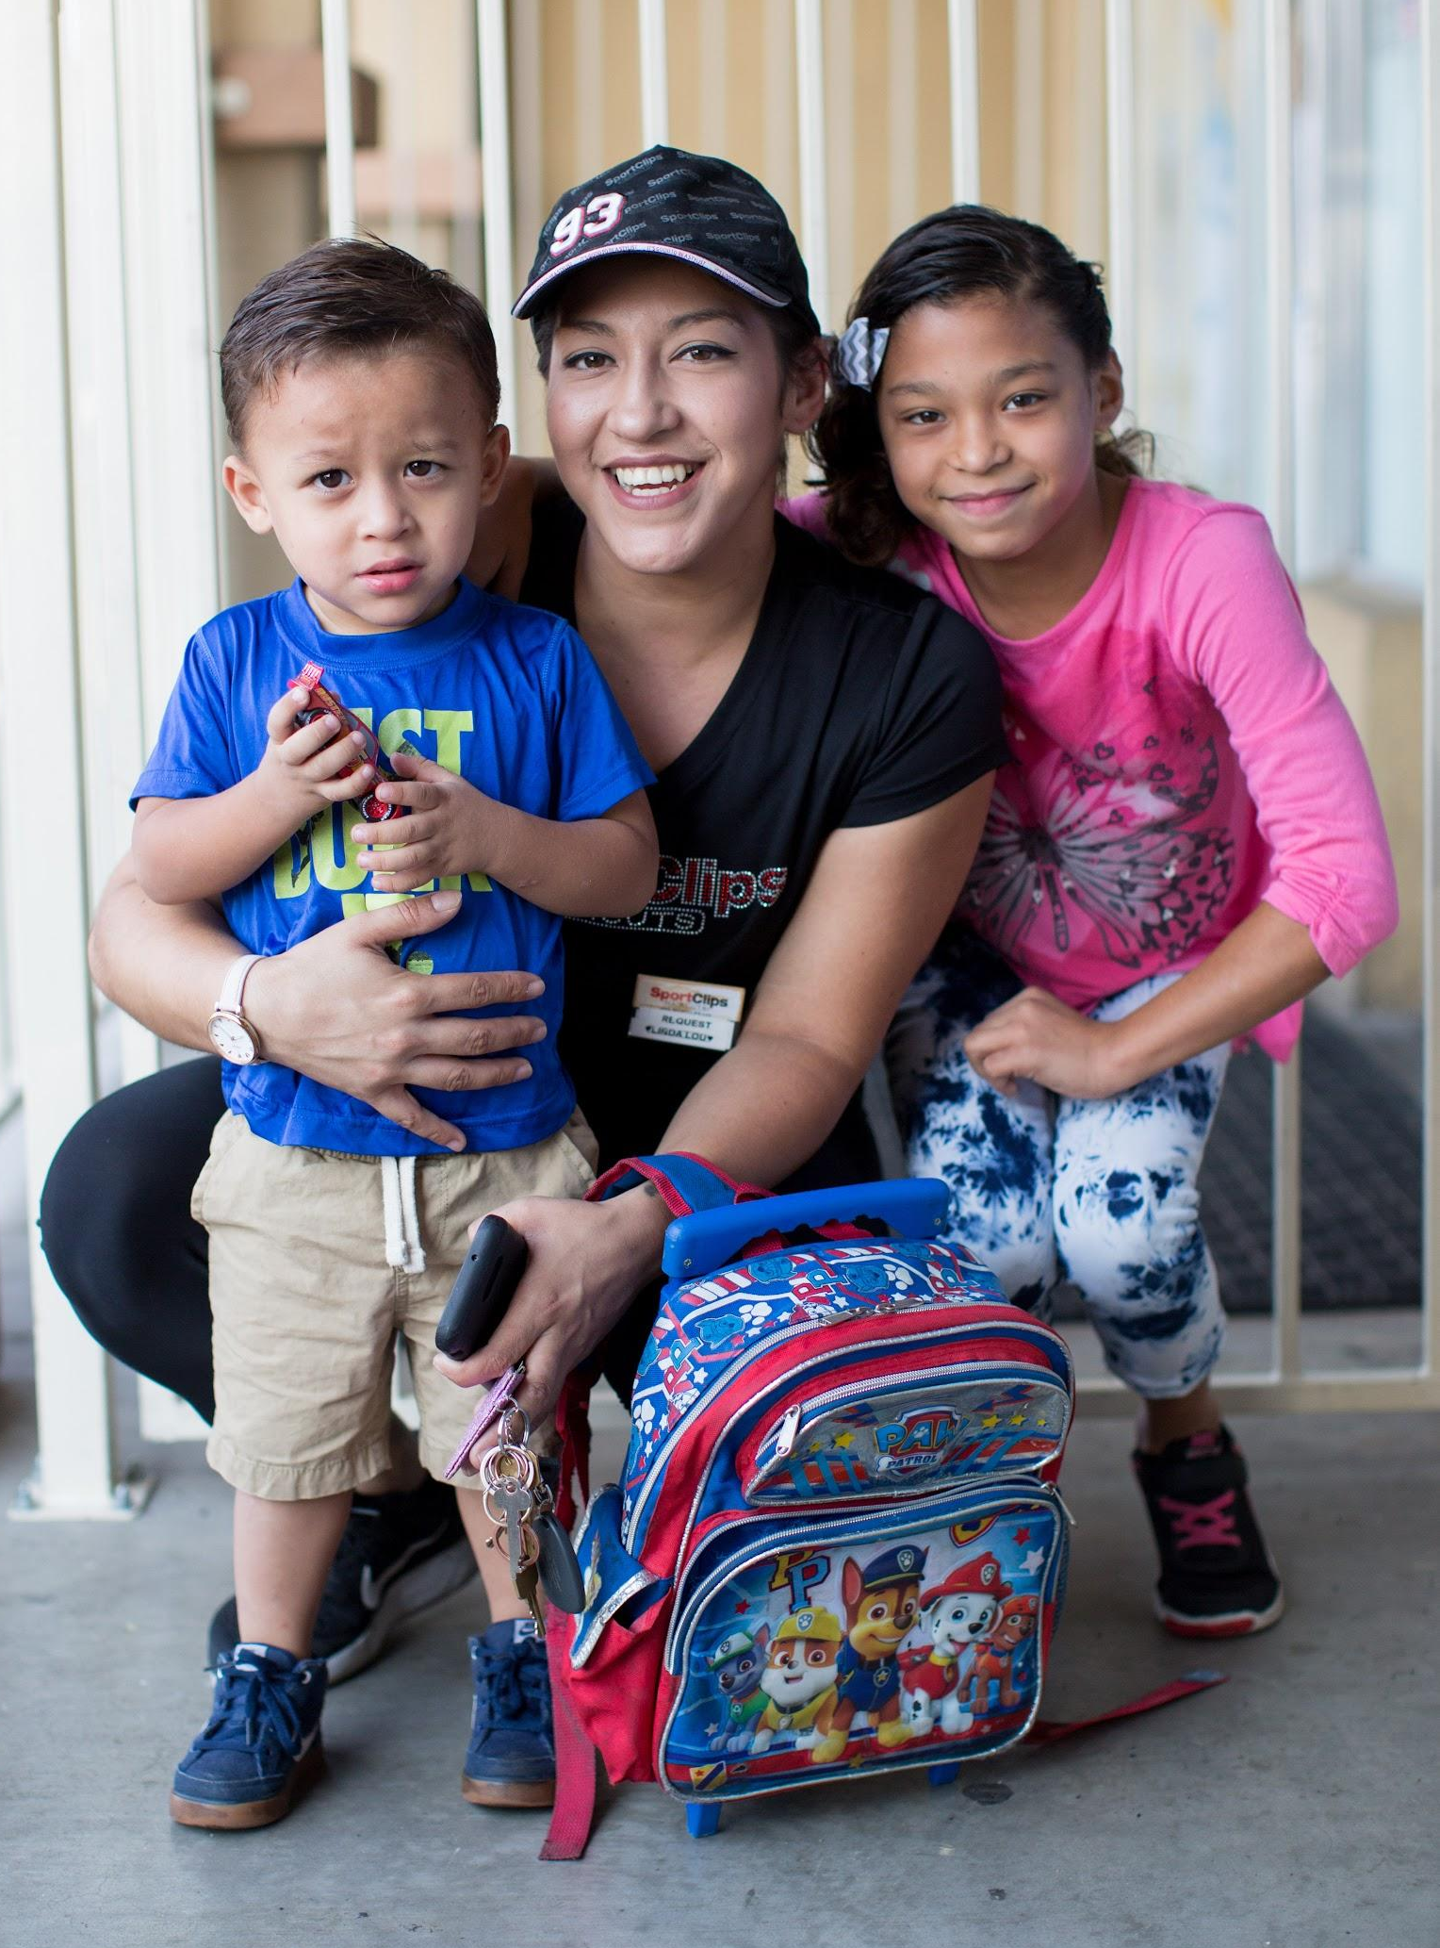
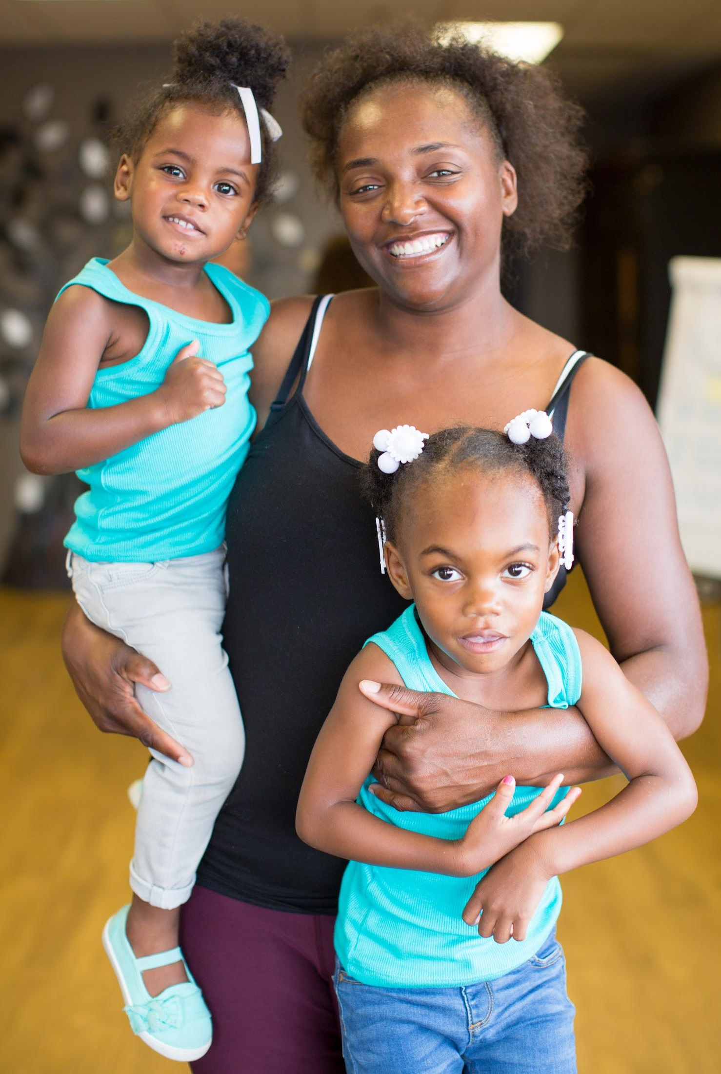
Our Clients
92% of our clients report annual income under the federal poverty line.
6% of our clients are homeless.
Nearly 100% of our clients experienced some form of abuse in childhood and/or as an adult.
Hope services are free to every woman regardless of income, documentation, or race.

Slide 6
What are ACEs?
Why do they matter?
Adverse Childhood Experiences, or ACEs, are traumatic childhood experiences, like abuse, neglect, or extreme family dysfunction. These traumas have detrimental effects on a person’s emotional, mental, physical, and relational health throughout adulthood.
The majority of our clients have a high ACE score, reflecting research that shows impoverished populations have significantly higher ACE exposure.

Slide 7
How does understanding trauma help Hope
better care for women?
Realizing trauma is widespread throughout our communities gives us a better service lens.
Adversity and trauma shape a person’s perceptions, interactions, behaviors & health. We recognize a client’s trauma symptoms and we respond calmly, with grace and love.

Slide 8
A Day at Hope
We walk alongside women in crisis:
Drug or alcohol dependence/recovery
Domestic or sexual abuse
Unplanned pregnancy
Postpartum mental health support
Unemployment or hardships of poverty
Homelessness
Sexual violence or trafficking
Re-entry support after incarceration
Family conflict/dysfunction
Parenting education and support
Navigating the reunification process with DCS

Slide 9
What does holistic care look like at Hope?
Hope offers life skills classes and job training to support the educational needs of our clients. Crisis counseling addresses the mental health needs of our clients. Mentoring and support groups address the emotional and relational needs of our clients. Faith-based classes meet the spiritual needs of our clients.
All program participation accrues points for food, clothing, and utility assistance, helping meet the physical needs of our clients.

Slide 10
How is Hope helping women & families in need?
→ Program participation earns points.
→ Points can be used in the Boutique on toiletries, baby items & diapers, clothing & household items.
→ Points can also be applied toward utility assistance & gas cards.
Hope relies on donations from community partners, churches & individuals! Thank you!

Slide 11
Free services
at Hope
All classes
All mentoring and support groups
Postpartum coaching & crisis counseling (requires screening approval)
Pregnancy testing and consultation
Food pantry, meals, food distribution
Community resource referrals
Maternity housing (Camp Verde only, by application approval)
Children’s program for moms in programming (some locations)
For clients in housing transition, use of our shower, washer/dryer, & phone

Slide 12
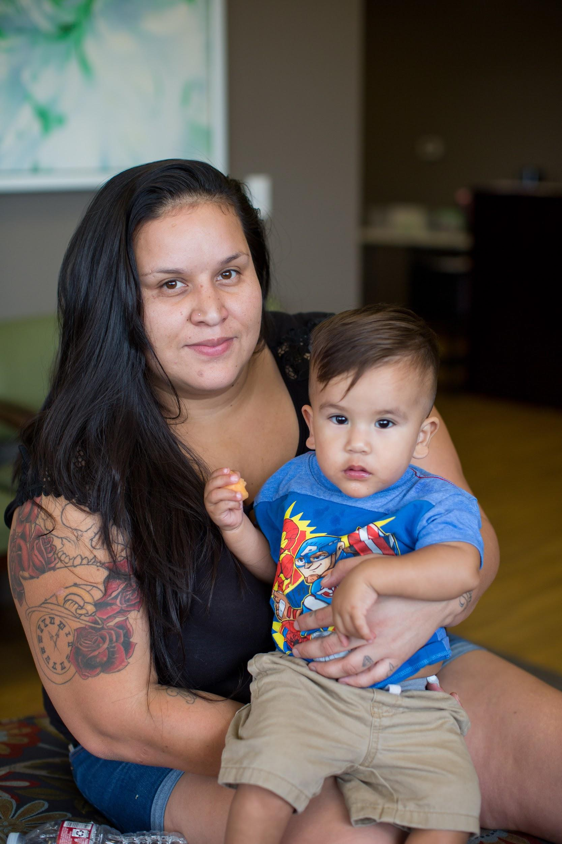
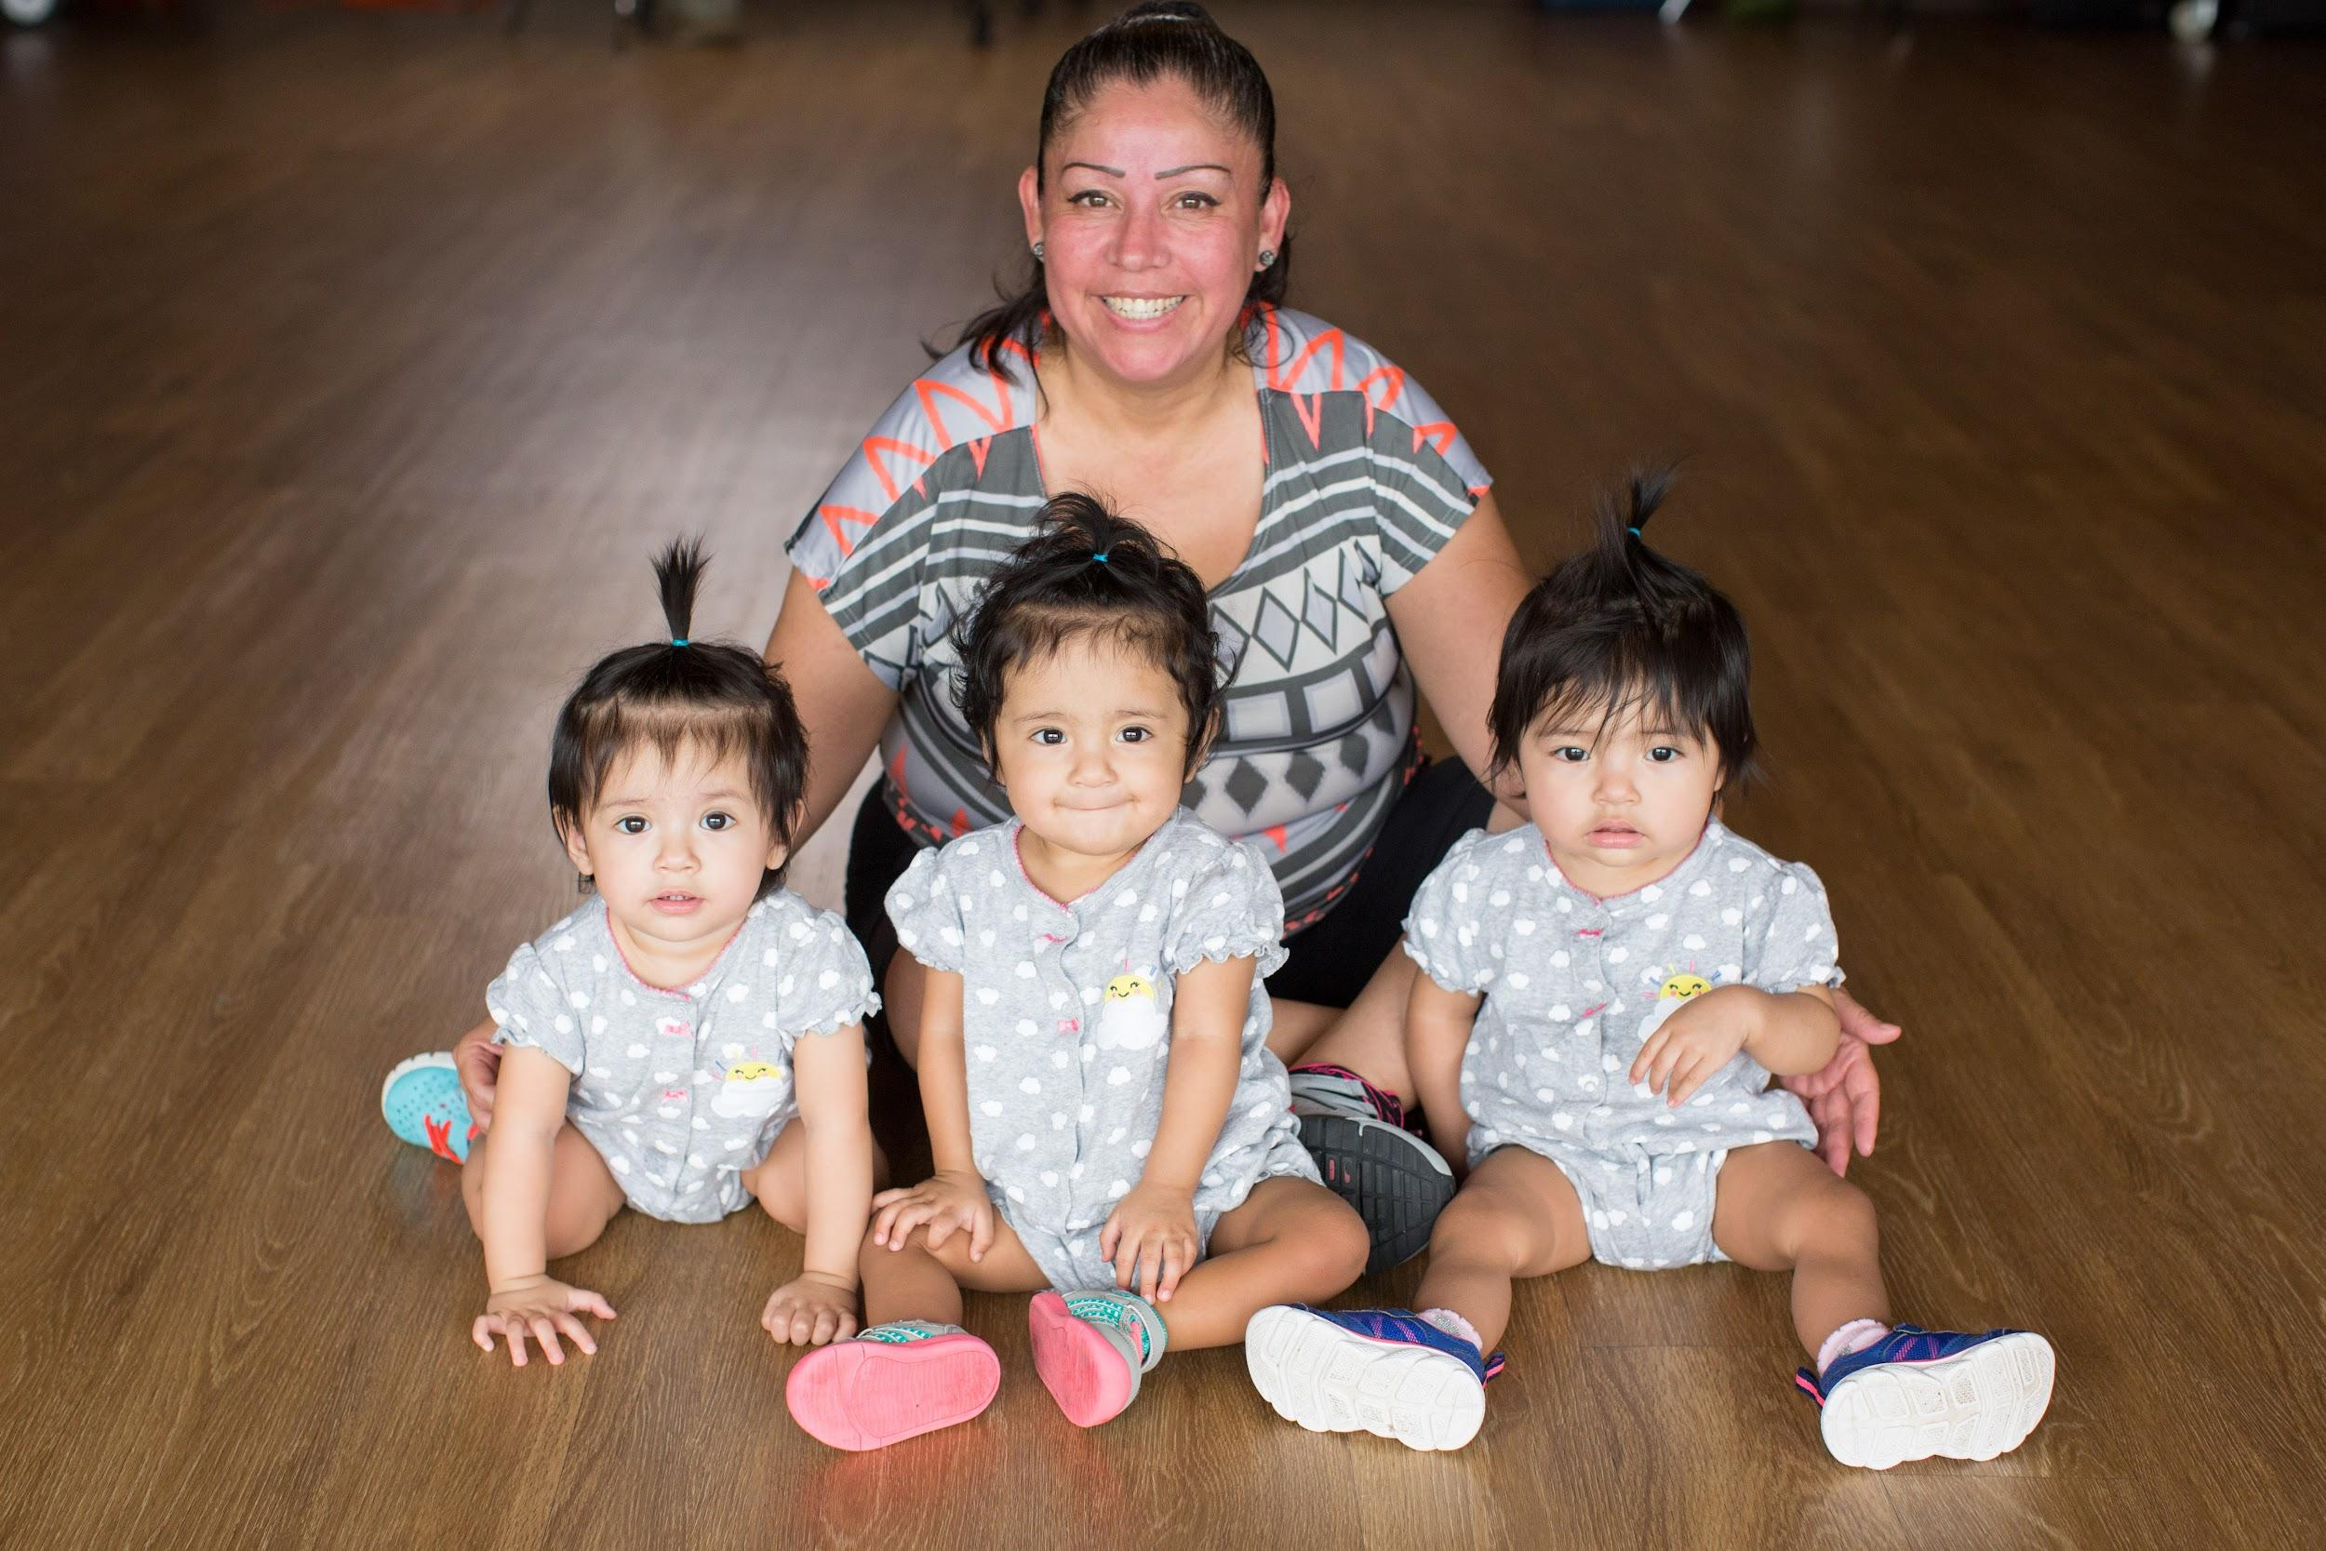
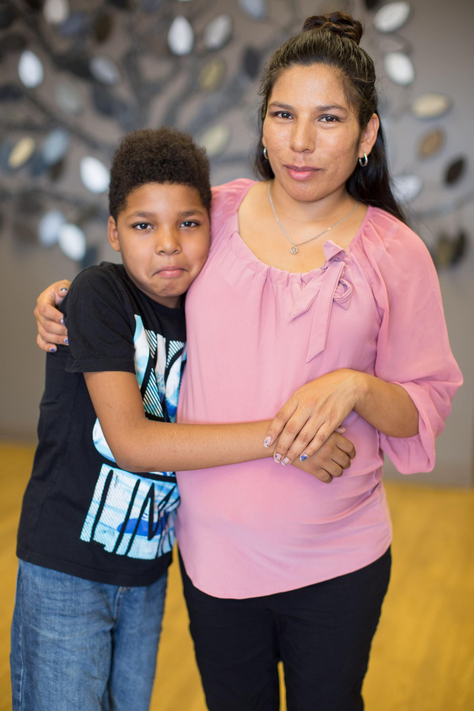

In the words of our clients…
Hope Women's Center 2021 (6 minutes)
https://youtu.be/lMWGS4s_mrc (2 minutes)

Slide 13
How is Hope
educating women
and teen girls?
Prenatal & postpartum classes & support groups
Life skills - finance, cooking, ESL, GED prep, job training, etc.
Evidence-based parenting classes
Faith-based studies
Anger Management
Abuse prevention classes
Boundaries & Safe People
Support/recovery groups of all kinds
Teen-focused classes & groups

Slide 14
How is Hope helping women heal and make positive change?
Trauma and abuse have long-lasting effects. Hope offers professional crisis counseling, crisis counseling support groups, and trauma-informed mentoring, giving women a safe place to process wounds of the past or present, while establishing goals for a new future.
Hope invested 3,736 hours of emotional and mental help in 2021!

Slide 15
How is HOPE helping women break cycles of abuse?
30-40% of children abused go on to become abusers themselves.
In 2021, Hope provided over 2,600 educational opportunities related to parenting and abuse prevention.
Our Hope Initiative program offers further support to moms navigating the DCS system.

Slide 16
How is Hope helping
moms reunify with
their children in DCS care?
Our Hope Initiative Program supports moms with children in DCS care by building on 3 aspects of connection:
Community - other local organizations & helpful resources
Individual - safe people who encourage mom’s accountability, goals, positive communication.
Peer - Hope staff who knows the DCS process and how to succeed in meeting goals and reunification.

Slide 17
How is Hope helping women with postpartum mood disorders?
As many as 1 in 2 mothers in poverty are affected by severe mood disorders or depression after giving birth, up to 5 years after delivery.
Women’s Health Innovations (WHI), leaders in Maternal Mental Health, partner with Hope Women’s Center by facilitating classes and support groups that give moms support and tools for navigating the stressors of motherhood and postpartum health.

Slide 18
Goals of our Educational Programming
Engage our clients in building relationship and community.
Equip our clients with knowledge.
Encourage behavioral change within our clients and within their families.
Trauma to Transformation!

Slide 19
How does Hope measure success?
In 2021, Hope’s six centers served 1,100 women, providing nearly 54,000 client services!
Each month, Hope averages
1,300 client visits.

Slide 20
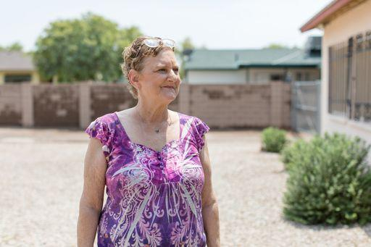
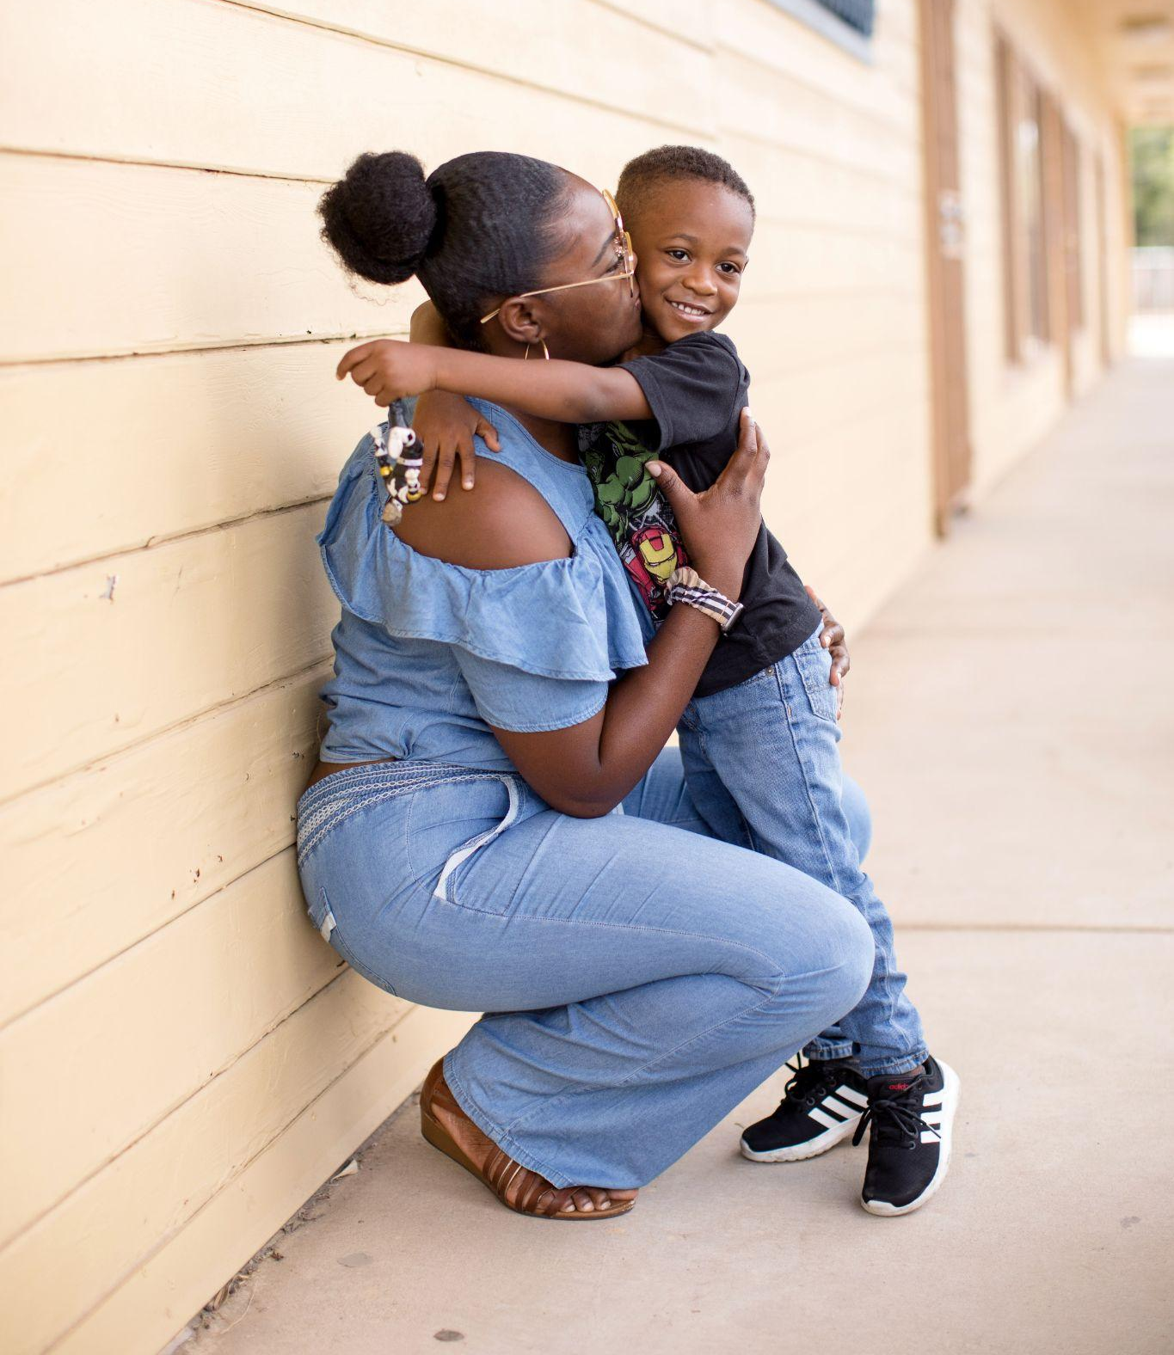
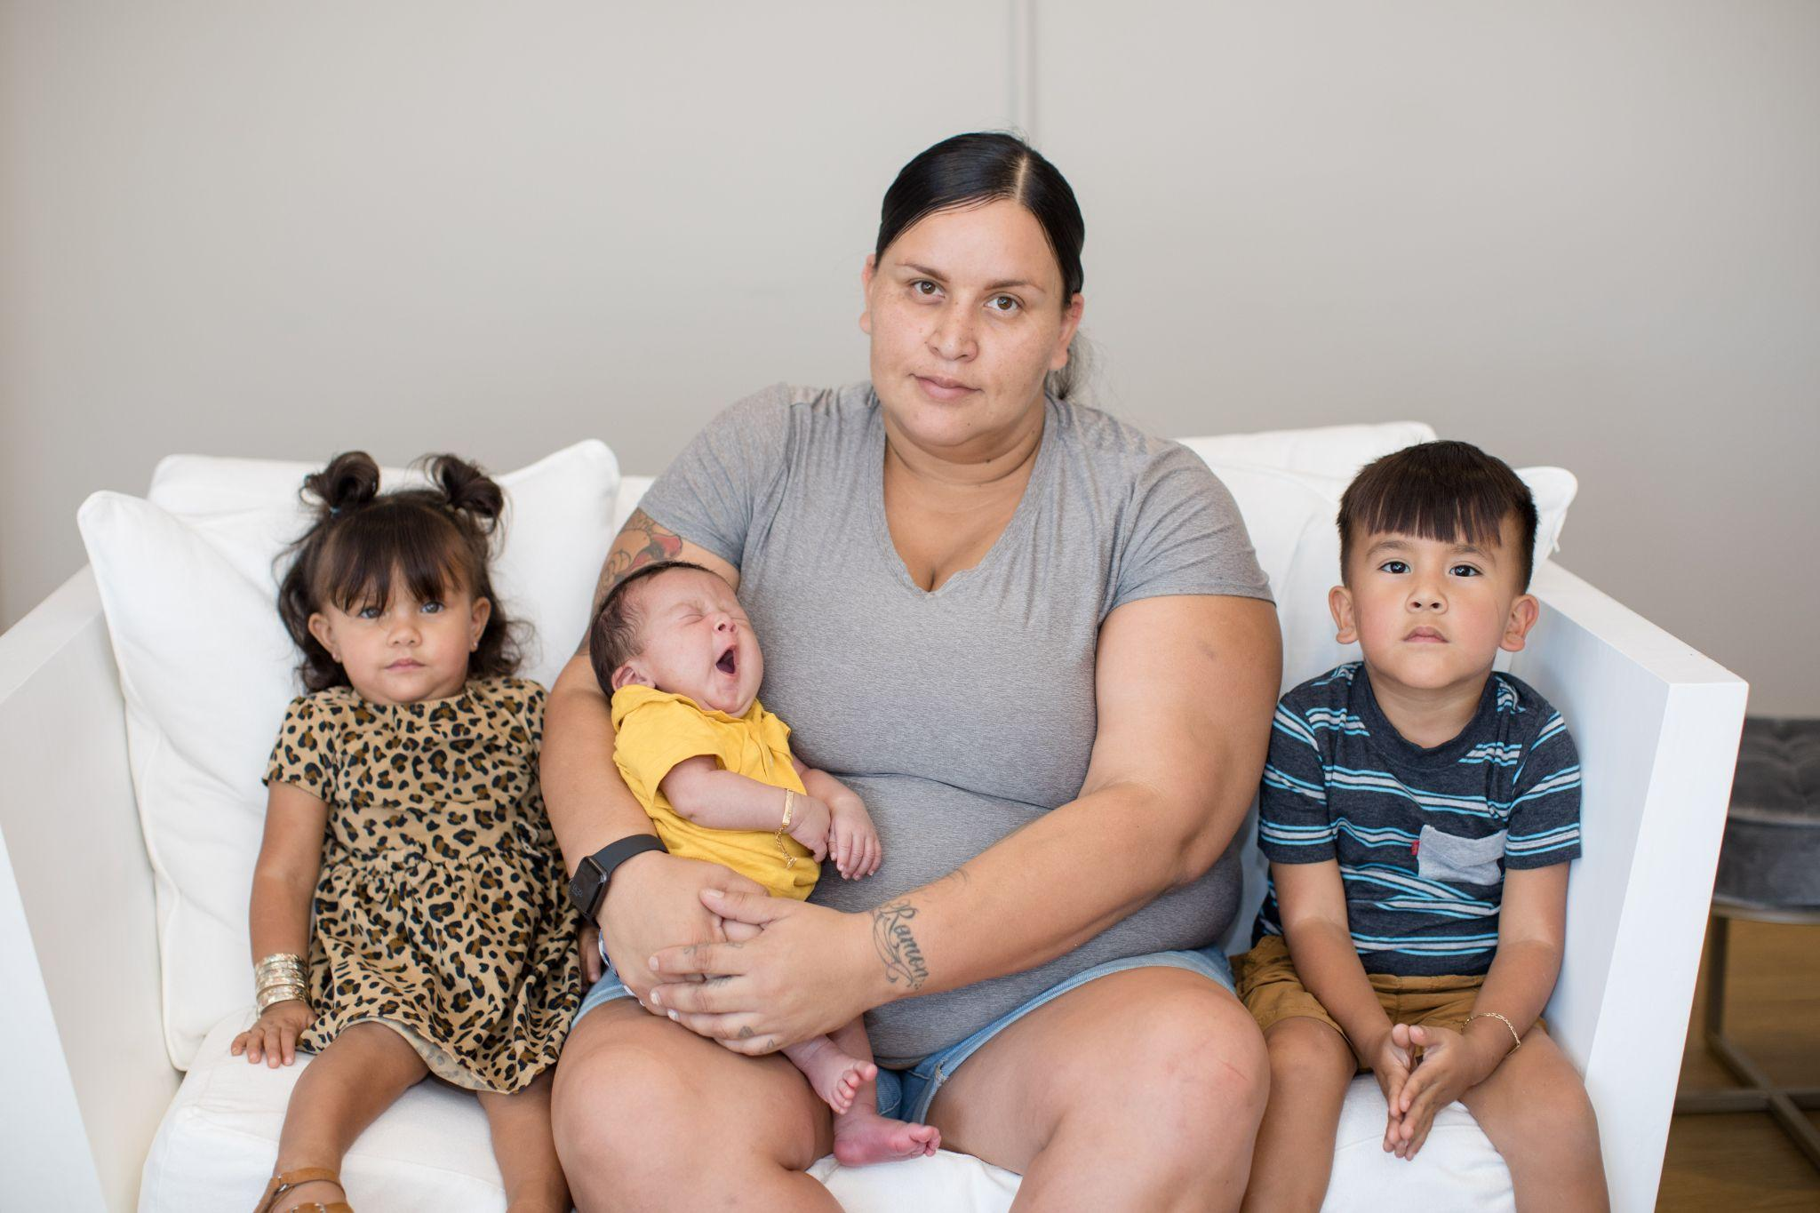
What’s your next step?
Schedule a tour of your nearest Hope Women’s Center.
Support our fundraising efforts.
Host a Hope donation drive.
Follow us on social media or sign up for our e-newsletter.
Designate your AZ charitable tax credit toward Hope.
Learn more at hopewomenscenter.org

