Slide 1

Graham CountY Substance Abuse Coalition

Slide 2

Who are we?
The first coalition meeting was held in 2003 as a cross system substance abuse coalition with the primary focus being methamphetamine. During a meeting in 2005 prescription drug misuse/abuse was identified as a merging problem in Graham County. The first prescription drug takeback was held at Mt. Graham Regional Medical Center.

Slide 3
Coalition Mission
Statement
“A substance abuse prevention community coalition that provides resources, support and education to the community through prevention and intervention to reduce substance abuse with a primary focus on reducing youth substance use”

Slide 4
Prevention
Community Education
Prescription takebacks
Parent classes
Annual Substance Abuse Awareness Conference
DUI Awareness
Who’s Watching the Punch
Substance Abuse Prevention Classes
School Education
  Trauma Informed Prevention
  Substance Abuse Education Classes
  Youth Leadership
  6th Grade Project
  Underage Drinking Awareness
  Partnership with Arizona State Prison

Slide 5
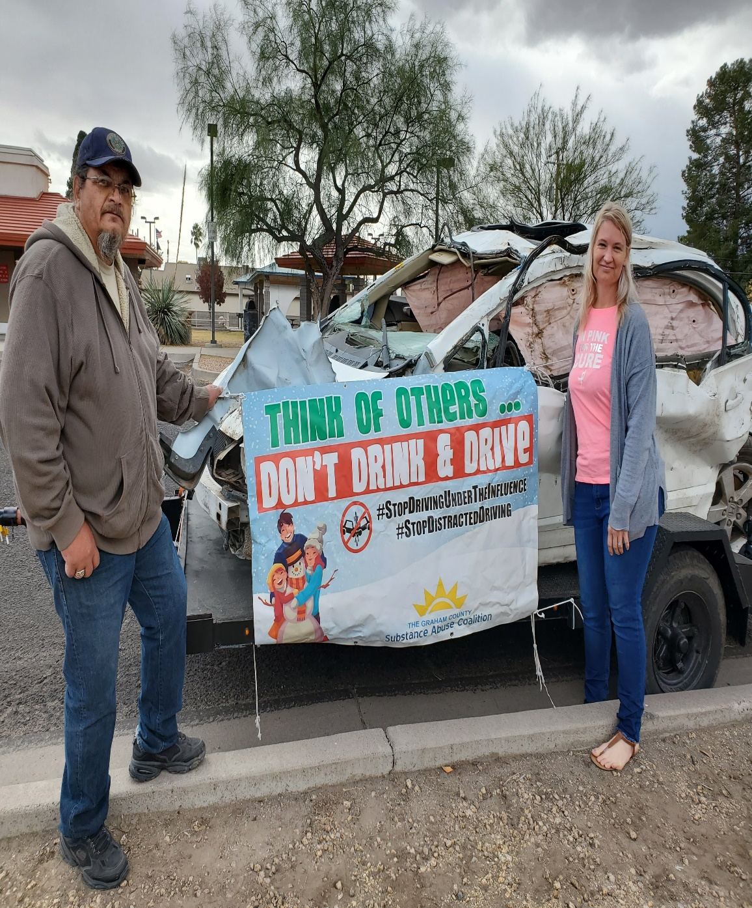


Slide 6
Recovery Supports
Recovery Angles
AA/CMA Meetings
Partnership with Arizona State Prison System
Community Education

Slide 7
Any Questions
Thank you!!!
Kathy Grimes 928 322-3385

