Slide 1

Department of Child Safety
Weekly Data Charts
Data as of week beginning 5.9.2022

Slide 2
Total Agency Staff
Note: Chart is updated bi-monthly. Current month data is preliminary.
Data Source: Director’s Monthly Staff Chart via HR Team, 4.18.2022

Slide 3
Field Staff
Number of Field Staff - Managers, Supervisors, Specialists, Trainees and Vacant Specialists
Note: Chart is updated bi-monthly. Current month data is preliminary.
Data Source: Director’s Monthly Staff Chart via HR Team, 4.18.2022

Slide 4
Field Specialists in Training
Number of Field Specialists in Training by Days of Service
Note: Chart is updated bi-monthly. Last update 4.18.2022
Data Source: Director’s Monthly Staff Chart via HR Team

Slide 5
Agency Turnover and Separation
Note: Chart updated monthly.
Data Source: DCS Monthly Staffing Report via HR Team, 4.18.2022

Slide 6
Agency Turnover and Separation by Position
Note: Chart updated monthly
Data Source: DCS Monthly Staffing Report via HR Team, 4.18.2022

Slide 7
Communications & Reports to the Hotline by date Intake received
Note: Period reported is based on Intake call date/time. Data refreshed Jan 2021-date. All counts include finalized Intakes. Intake report counts include all dispositions (no jurisdiction, QA review, Action Taken, Field Investigation, null). Screen In % shows reports as a percentage of total Hotline Communications.
Data Source 1/1/2021 – 5/9/2022: Guardian Advance Find extract.
Data Source through 12/31/2020: Hotline Scorecard

Slide 8
Completed Reports vs. Assigned New Report
Note: Updates to Jan-Sept data resulted in a decrease in closed reports due to Assessments re-opened to complete required process/data entry. Counts exclude Intake reports with disposition of no jurisdiction, QA review and action taken.
Data Source 1/1/2021 – 5/9/2022: Guardian Advance Find extract. New Intake report period is based on Intake Finalization Date. Closed Reports is based on Assessment End Date.
Data Source through 12/31/2020: Tableau – CPS Reports Open and Closed

Slide 9
Reports Received - All Sources
2021 vs. 2022 weekly comparison
Data Source: Dynamics CE Advance Find via Intake team 5.9.2022

Slide 10
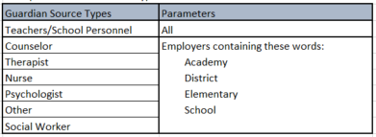
Reports Received – *School Setting Source
2021 vs. 2022 weekly comparison
Data Source: Dynamics CE Advance Find via Intake team 5.9.2022.
*School setting parameters changed Week 5 of 2021 due to change in Source Type options with Guardian implementation. Week 25 replaced “Teacher” option with “School Personnel” to reduce frequency of “Other” being selected. All Guardian parameters for School Source Types are summarized in table to right.

Slide 11
Reports Received – Law Enforcement Source
2021 vs. 2022 weekly comparison
Data Source: Dynamics CE Advance Find via Intake team 5.9.2022

Slide 12
Reports - Open vs. Overdue
Note: Counts exclude Intake reports with disposition of no jurisdiction, QA review and action taken.
Data Source 1/1/2021 – 5/9/2022: Guardian Advance Find extract. Intake report period is based on Intake Finalization Date.
Data Source through 12/31/2020: DCS Tableau Dashboard, Overdue Reports

Slide 13
Count of Workers with 25 or more Open Reports by Section
Note: Counts include Intake reports with disposition of field investigation. Open status is based on Assessment with no (null) end date.
Data Source: Guardian Advance Find extract. 5.9.2022

Slide 14
Entries & Exits
Notes:
1. Counts exclude entries added in error.
2. Counts include removal entries in Guardian without the child’s name - this issue has been resolved and is being monitored
3. Comprehensive data validation is still in process. Currently estimating ~5% error margin on removals with removal date after Feb 1, 2021.
Data Source as of 5/9/2022: Guardian Advance Find extract.

Slide 15
Children Receiving In Home Services
Children with Case Plan Goal – Remain with Family
NOTE: Jan & Feb 22 updated to capture lagging data and continuous data quality improvements. Chart updated monthly. Guardian data report criteria includes: Case =Open, Child is active person in case with role of child, Child is not removed, Case Plan status is draft, or is finalized with Effective date on or before last day of report month, or is expired up to 120 days if there is not a current or draft plan, most recent Permanency Goal (including drafts) = Remain with Family. Criteria for chart displaying No Case Plan: Case = Open, Child is active person in case with role of child, Child is not removed, case plan does not contain data or does not contain a permanency goal. Data as of 5.2.2022.
Data Source since 1.1.2021: Guardian CE Extract
Data Source through 12.31.2020: DCS Monthly In-Home Care Report

Slide 16
Children in Out-of-Home Care
(0-17 years old)
NOTE: Nov 21-Apr 22 updated to capture lagging data and continuous data quality improvements. Other category includes Runaway, Missing/Abducted & No Placement Entry (placement not yet entered or date is misaligned). Data includes: Child removal date is <= report period end date, return date is null or > than report period end date, most recent caregiver date entered on Guardian Placement table is >= removal date, caregiver end date is null or > report period end date. Estimated margins of error in distribution of caregiver categories is ~4-8% since Jan 2021.
Data Source 1/1/2021-5/9/2022: CE Advance Find exports
Data Source through 12/31/2020: DCS Monthly Out-of-Home Care Report

Slide 17
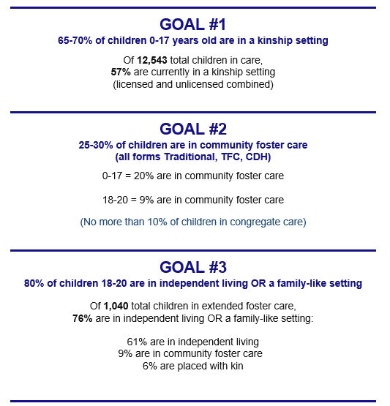

Slide 18
Runaway Youth
NOTE: Nov 21-Apr 22 updated to capture lagging data and continuous data quality improvements. Data inclusions: Child removal date is <= report period end date, return date is null or > than report period end date, most recent caregiver date entered on Guardian Placement table is >= removal date, caregiver end date is null or > report period end date. Estimated margins of error in distribution of caregiver categories is ~4-8% since Jan 2021.
Data Source 1/1/2021-5/9/2022: CE Advance Find exports
Data Source through 12/31/2020: AMPM - OOH Statewide

Slide 19
Children Missing/Abducted
NOTE: Nov 21-Apr 22 updated to capture lagging data and continuous data quality improvements. Data inclusions: Child removal date is <= report period end date, return date is null or > than report period end date, most recent caregiver date entered on Guardian Placement table is >= removal date, caregiver end date is null or > report period end date. Estimated margins of error in distribution of caregiver categories which includes children Missing/Abducted is ~4-8% since Jan 2021.
Data Source 1/1/2021-5/9/2022: CE Advance Find exports
Data Source through 12/31/2020: AMPM - OOH Statewide

Slide 20
Children at Placement Center
Data Source CE Advance Find exports, placements table filtered to Placement Center 5.9.2022

Slide 21
Children Age 0 -17 in Congregate Care
NOTE: Nov 21-Apr 22 updated to capture lagging data and continuous data quality improvements. Data inclusions - Child removal date is <= report period end date, return date is null or > than report period end date, most recent caregiver date entered on Guardian Placement table is >= removal date, caregiver end date is null or > report period end date. Estimated margins of error in distribution of all caregiver categories is ~4-8% since Jan 2021. Margins of error in distribution of Shelter and Other Congregate Care buckets is higher – root cause analysis was performed and a solution is in process.
Data Source 1/1/2021-5/9/2022: CE Advance Find exports
Data Source through 12/31/2020: DCS Monthly Out-of-Home Care Report

Slide 22
Young People in Extended Foster Care
(18-21 years old)
NOTE: Nov 21-Apr 22 updated to capture lagging data and continuous data quality improvements. Other category includes Runaway, Missing/Abducted & No Placement Entry (placement not yet entered or date is misaligned). Data inclusions: Child removal date is <= report period end date, return date is null or > than report period end date, most recent caregiver date entered on Guardian Placement table is >= removal date, caregiver end date is null or > report period end date. Estimated 6-12% margin of error in distribution of caregiver categories since Jan 2021.
Data Source 1/1/2021-5/9/2022: CE Advance Find exports
Data Source through 12/31/20: DCS Monthly Out-of-Home Care Report of 1.20.2021

Slide 23
SVO Referrals
NOTE: Chart updated monthly. Total referrals is sum of New Referrals plus continuation/extension of service for same person to either same or new provider. Includes migrated SVOs (Case Aide Visitations), and SVOs in statuses of Open, Closed, Provider Assigned and In Process. Excludes SVOs in pending status (pending Approval, Pending Field Information). Extended Referrals which are currently on Waitlist are due to delay in request for extension.
Data Source: CE Advanced Find Export, 5.2.2022

Slide 24
Ombudsman Complaints
Total Complaints by Month by Origin
Data Source: DCS Ombudsman Office, through 4.25.2022.

