Slide 1
Counter Drug Task Force (CDTF)
Counter Drug Task Force
Operations
1SG Jaime Sotomayor

Slide 2
Arizona Counterdrug
Mission Statement
Mission: The Arizona National Guard Counterdrug Program aligns with the Deputy Assistant Secretary of Defense (DASD) Counternarcotics and Stabilization Policy (CNSP) guidance to utilize military personnel, equipment, and military skills in compliance with approved Title 32, U.S. Code 112 activities to support state, local, tribal and federal law enforcement agencies.
Notes:
From our Draft NGCD Strategy.
Vision & Mission briefed at 2104-2018 POM in April

Slide 3
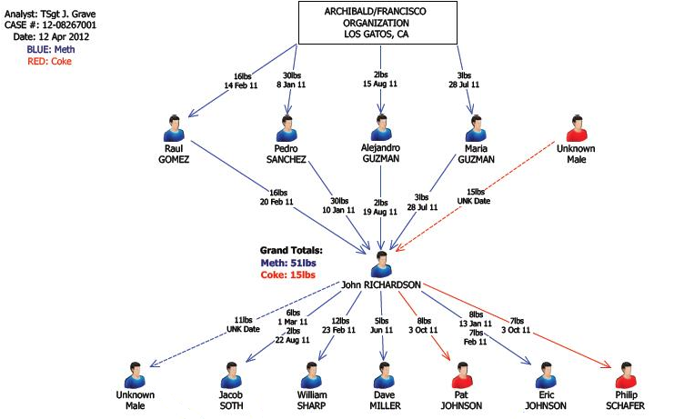
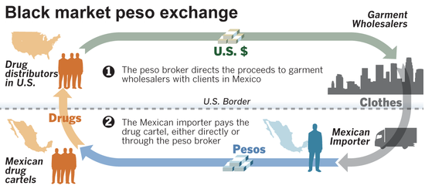
Authorized Activities
Analyst Support
  Focus on four core competencies:
    Link Analysis
    Document exploitation
    Commodity-Illicit financial analysis
    Case construction
Notes:
Brief Explanation of each. Ask Cichon if she wants to add / accent any points for each mission.

Slide 4
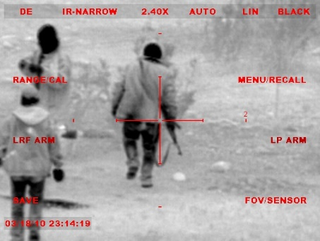
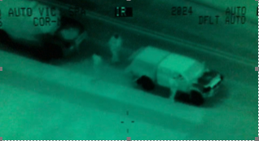
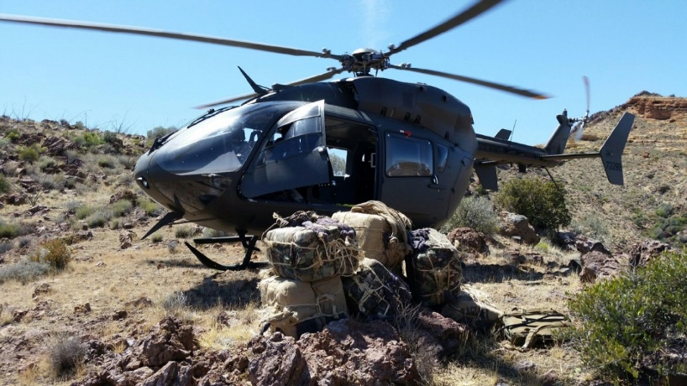
Ground and Aerial Reconnaissance and Observation
Assist Law Enforcement in the successful interdiction of narcotics through low visibility reconnaissance and observation activities.
Underlying priority of all operations is preservation of human life and officer Safety.
Capable of operating in arduous terrain and conditions covertly in rural and urban environments.
Always in a support role at the direction of the LEAs.

Slide 5


Effectiveness
FY 22
Meth: 9,460 lbs
Cocaine : 13,350 lbs
Heroin: 98 lbs
Fentanyl: 13,176,750 pills
Overall Worth of Total Seizures: $86,084,985
FY 21
Meth: 3,107 lbs
Cocaine: 959 lbs
Heroin: 64 lbs
Fentanyl: 3,279,379 pills
Overall Worth of Total Seizures: $45,051,364
FY 20
Meth: 2,300 lbs
Cocaine: 233 lbs
Heroin: 222 lbs
Fentanyl: 1,143,771 pills
Overall Worth of Total Seizures: $37,208,655
FY 19
Meth: 1,684 lbs
Cocaine: 124 lbs
Heroin: 252 lbs
Fentanyl: 374,570 pills
Overall Worth of Total Seizures: $26,319,733

Slide 6
Counter Drug Task Force (CDTF)
Drug Demand Reduction and Outreach (DDRO)
CPT Matt Harvey
SMSgt Michael Gunderson

Slide 7
Counter Drug Task Force (CDTF)
Drug Demand Reduction and Outreach (DDRO)
Started March of 2018 with 3 personnel.
Currently sustaining 18 full time personnel.

Slide 8
Counter Drug Task Force (CDTF)
DDRO Mission
To enhance supported coalitions and community-based organizations, partnering with local, state, and tribal organizations in the delivery of prevention leadership, expertise, and evidence-based initiatives to minimize Arizona’s demand for drugs, substance abuse, and misuse.

Slide 9
Counter Drug Task Force (CDTF)
DDRO Lines of Effort:
Support increased prevention efforts in critical need areas
Support facilitation of evidence-based/ evidence-informed programming in schools across Arizona
Promote increased perception of harm associated with substance abuse and misuse

Slide 10
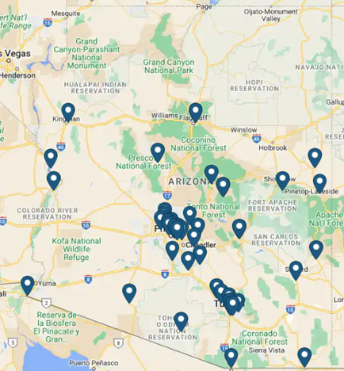
DDRO Supported CBOs and Agencies by Geography
Community Based Organizations (CBO)
Arizona Narcotic Officer’s Association
Arizona Health Care Cost Containment System
Arizona Narcotic Officer’s Association
Chandler Coalition on Youth Substance Abuse (CCYSA)
Dispose-A-Med
Governor's Office of Youth, Faith and Family
Pima Council on Aging (Be Med Smart)
Pima County Counter Narcotics (CNA)
Portable Practical Educational Preparation Inc. (PPEP)
South Eastern Arizona Behavioral Health Services (Douglas)
Substance Abuse Coalition Leaders of America (SACLAz) includes:
Arizona Youth Partnership
BeMedSmart Coalition
South Mountain Coalition
Tempe Coalition
Yavapai County Substance Abuse Coalition (MATFORCE)
Graham County Substance Abuse Coalition
Liberty Partnership-Kino Neighborhood Councils
Marana Prevention Alliance
Pima County Community Prevention Coalition
Santa Cruz County Drug Free Community Coalition (DFCC)
Stand Up AJ
Way Out West Coalition (WOW Coalition)

Slide 11
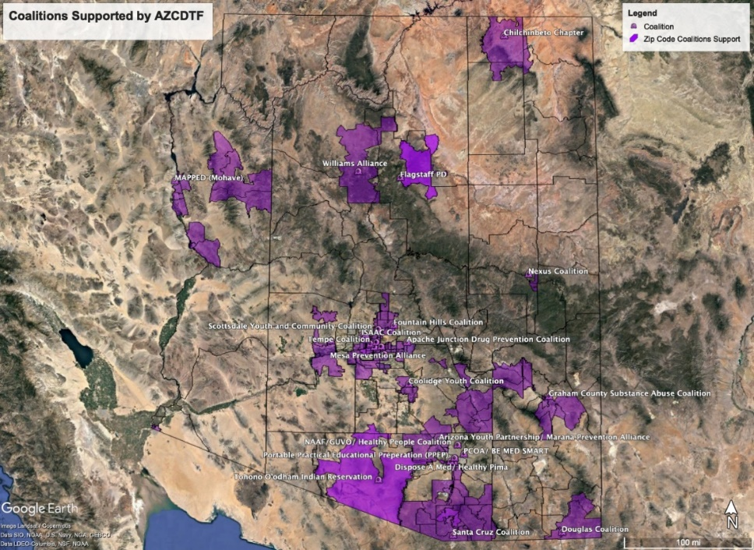
Counter Drug Task Force (CDTF)
Statewide DDRO Prevention Support
Focused effort toward high risk, high need communities, specifically students in the 6-12th grade and their parents.

Slide 12
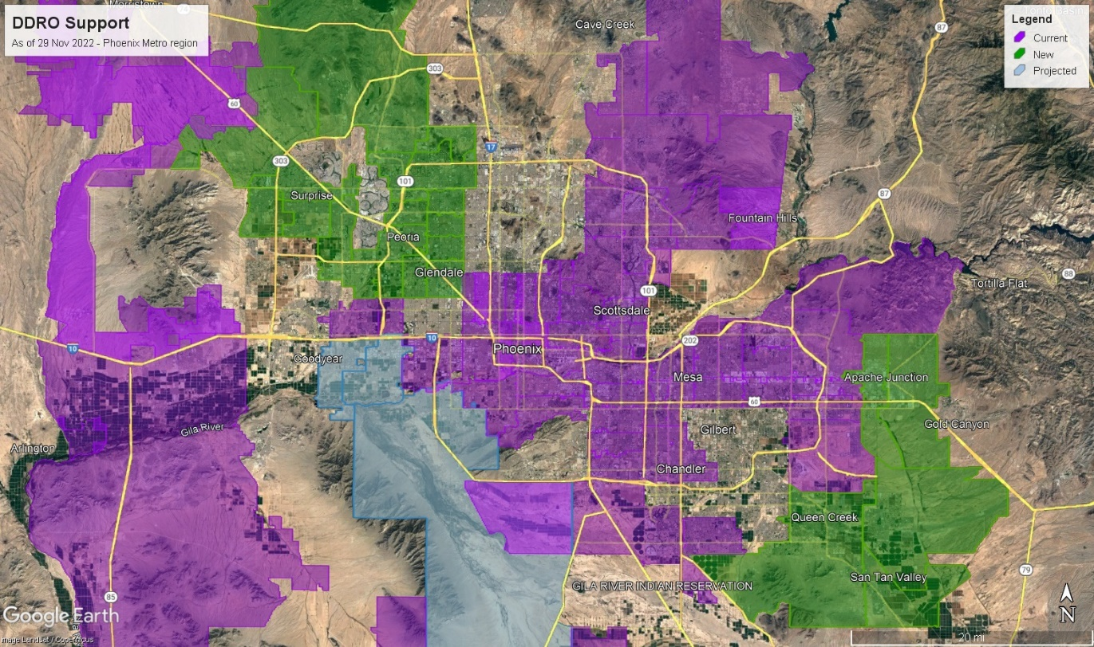
Counter Drug Task Force (CDTF)
SACLAZ Prevention Coalitions
FY21 Added Glendale, Peoria, Queen Creek, Apache Junction
FY22 Surprise and El Mirage
FY23 Goals: Tolleson, Avondale, Laveen

Slide 13
Return of Investment
DDRO direct support since FY21:
Adults Trained in Prevention Skills and Knowledge:
2,833
Prevention Funds Awarded Through Grant Writing Support:
$5,690,000
Youth Educated Through
Evidence Based/ Informed Curriculum:
23,072
Supported Collection of Prescription Medication:
17,137 lbs.

Slide 14
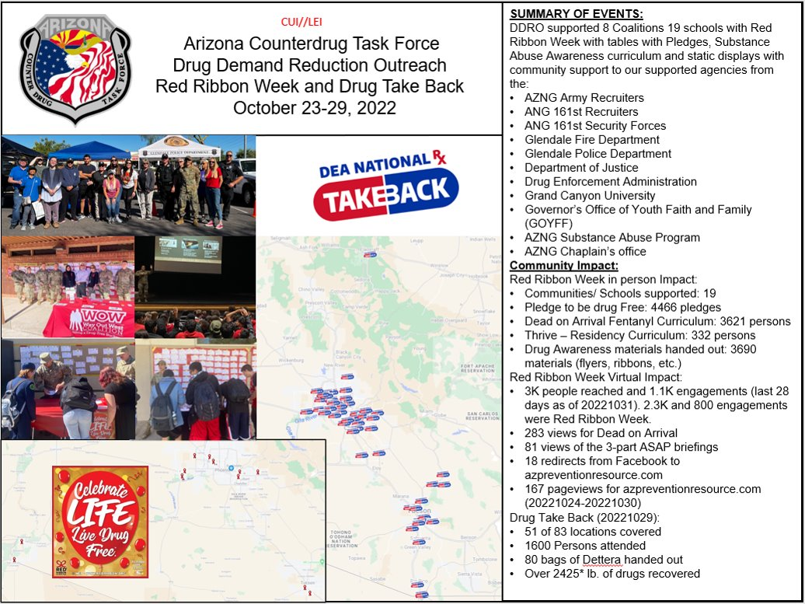
RRW Storyboard

