Slide 1


Tempe Coalition
StandUP AJ
Mentorship

Slide 2
Our Journey
Intro of two Coalitions
Building Capacity with People and Data
Sustainability and Cultural Competence
1
3
5
2
4
6
Funding for Mentoring
Prioritizing substances based on data and increasing awareness
DFC Award

Slide 3
Tempe Coalition
Who We Are
Tempe Coalition is comprised of residents and professionals who live and work in the community to collectively educate and advocate for the reduction of risk behaviors among Tempe youth.
The Coalition members represent a wide range of community sectors including: business, media, law enforcement, schools, substance use providers, youth, parents, youth serving organizations, civic groups, healthcare professionals, governmental agencies and faith-based organizations.
Our Vision
All Tempe youth are living at their full potential.
Our Mission
Reduce youth risk behaviors and promote health and wellness through awareness, education, advocacy and connecting to community resources.

Slide 4
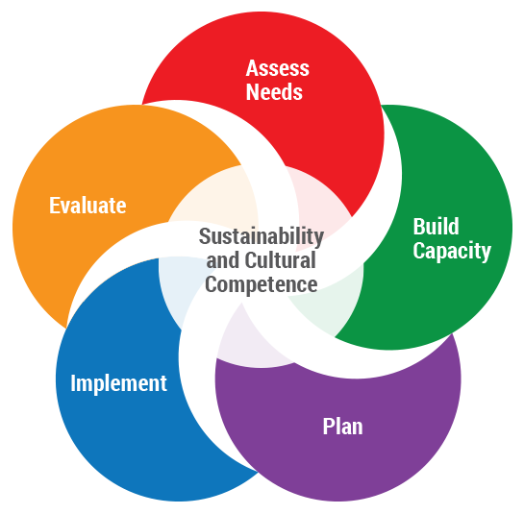
Best Practice Process

Slide 5
About this template
Implementing SPF
ASSESS NEEDS
Data Collection from Coalition Members
Community Surveys
Bylaws and Operating Procedures
BUILD CAPACITY
Created Job Descriptions
Created Roles and Responsibilities
Logo (from the Community)
Youth Recruitment
Community Events

Slide 6
70 members
200 surveys
342 followers
Started with 15 members the first meeting
Increased from 40 surveys in the first community assessment
Instagram, Facebook and Twitter

Slide 7
7,000
Monthly reach on Facebook, Whoa look at the growth!

Slide 8
TRAINING
Preparing the coalition to work with confidence through a data driven coalition involved to following trainings:
Intro to Effective Prevention
The Strategic Prevention Framework
Coalition 101
Needs Assessment
Capacity Building with Members

Slide 9
Implementing SPF
PLANNING
Strategic Planning, Mentor Check Ins
Logic Model Development
Consistent General and Executive Committee Meetings
Determining readiness for Opioids and Fentanyl
Becoming a Narcan distributor

Slide 10
32 boxes
Narcan is now being distributed. And this is just the first couple weeks. 150 more ordered

Slide 11
StandUP AJ
Who We Are
Established in July of 2020, StandUP AJ is a group of community members and organizations that share the common desire and goal of preventing substance misuse in our beloved community of Apache Junction. With our dedication, hard work, and collaborative efforts we strive to do just that. It is our own community driven empowerment that will help a thriving, healthy Apache Junction community rise to the top!
Our Vision
Apache Junction youth and community standing together for healthy life choices, choosing to be drug free, and building bright futures.
Our Mission
Collaborating with the Apache Junction community to ensure brighter futures through eliminating youth substance and alcohol misuse by providing trauma informed education and advocacy in order to provide opportunities that promote a thriving and healthy lifestyle.

Slide 12

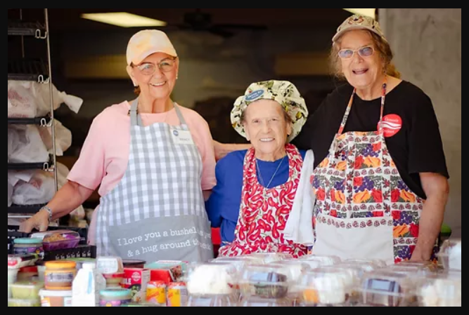


SPOTLIGHTS
Community, Youth, Member

Slide 13
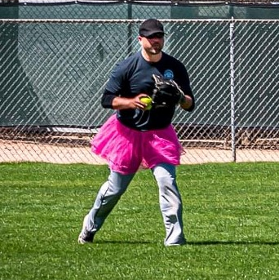

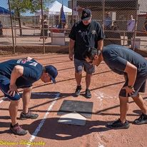
Battle of the Badges
PD vs FD Softball
Trophy and Perpetual Plaque
Allows community to see human side of first responders
Non-profits invited

Slide 14
Hope introduces your mind to your heart
Rick Miller, Kids at Hope Founder

Slide 15




Social Media/Website
fb Twitter IG standupaj.org
SACLAZ Toolkit
Community Events
Coalition Awareness
Features
Self Care Sunday
Family First Friday

Slide 16
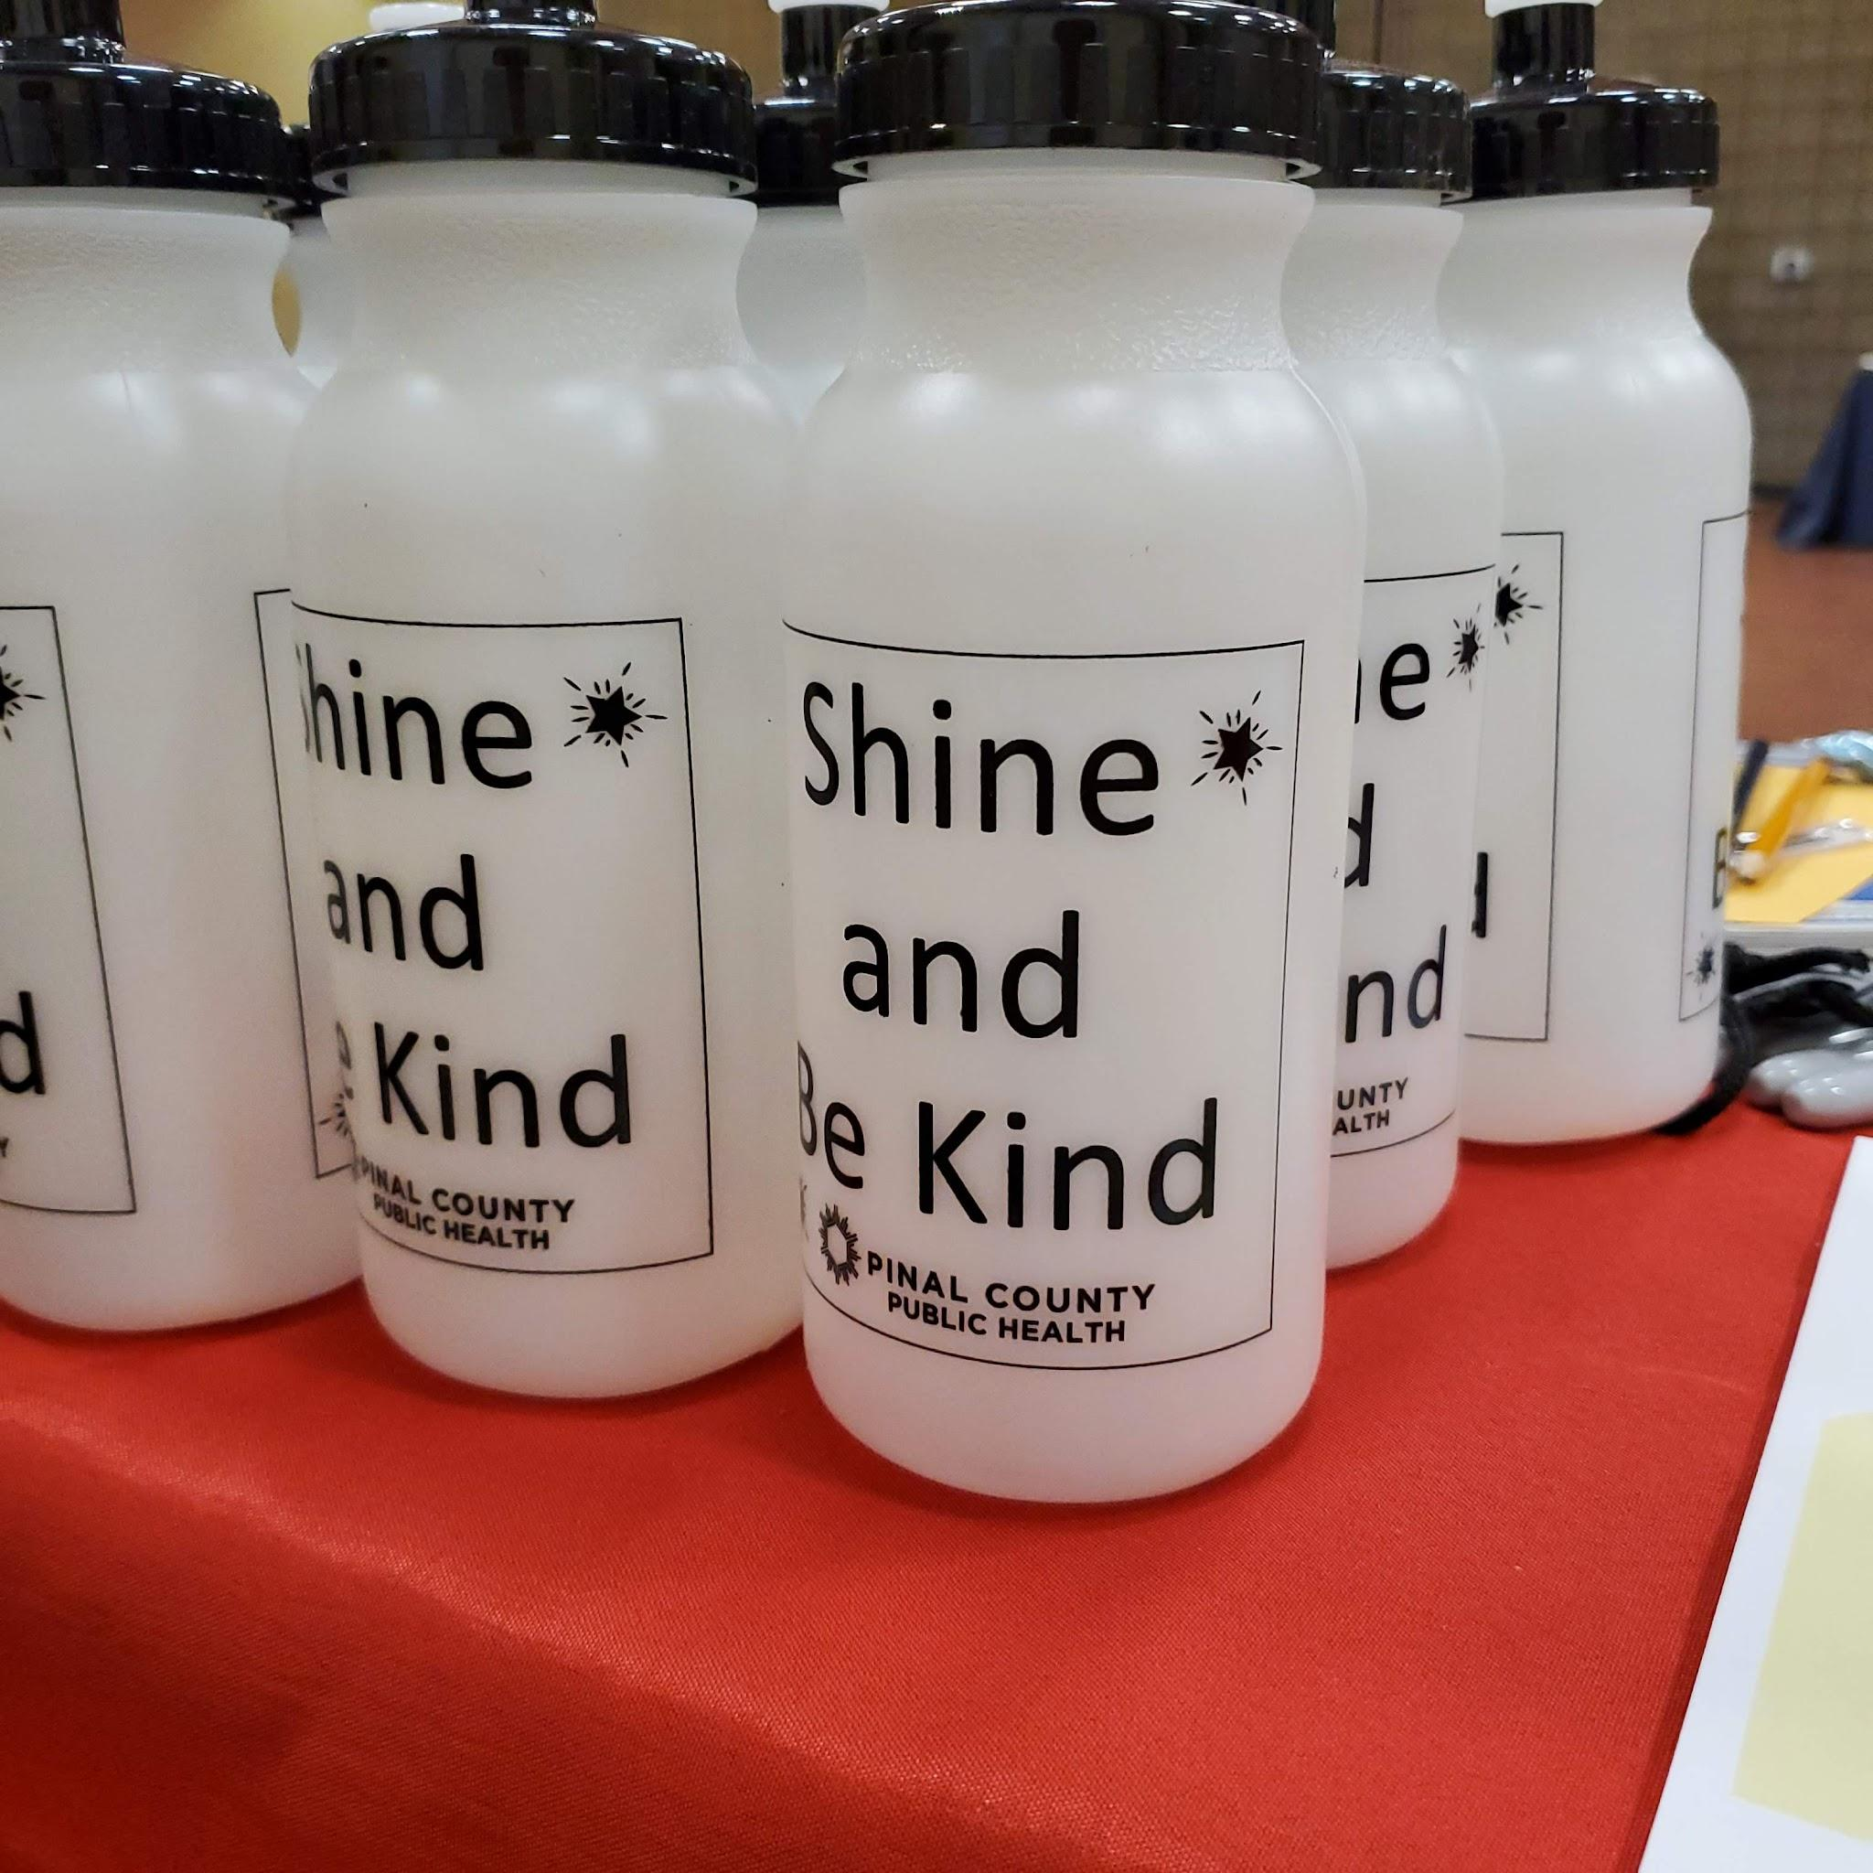
Additional Notables
Too Good for Drugs
Active Parenting of Teens
Back to School Event
Location, location, location
Buddy Benches
Building Partnerships
Needs Assessment
Second Saturdays

Slide 17
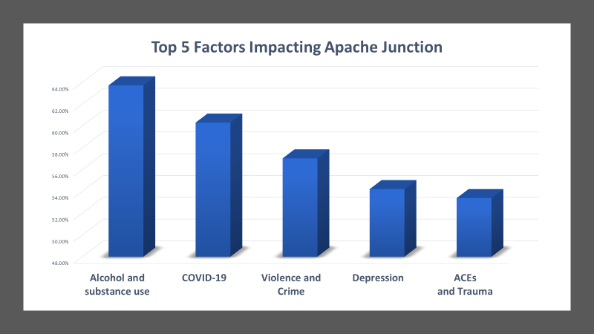

Slide 18
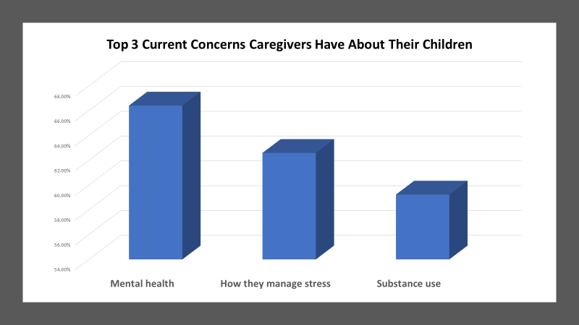

Slide 19
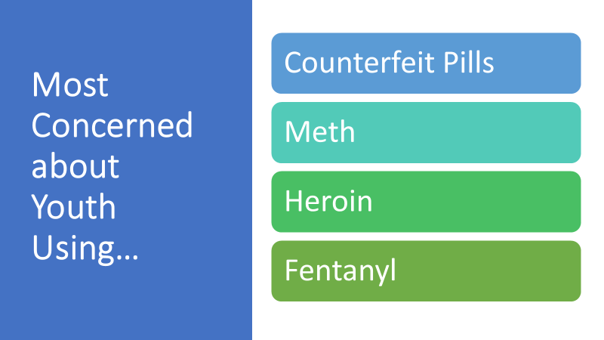

Slide 20
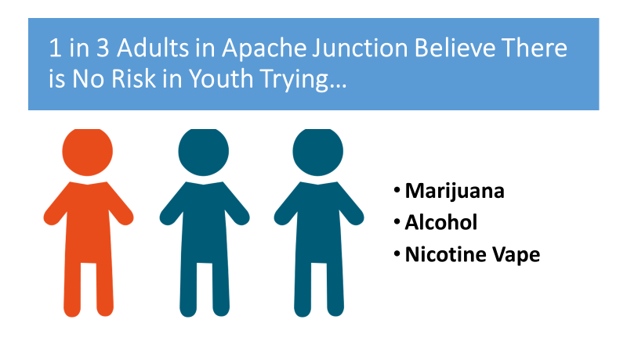

Slide 21
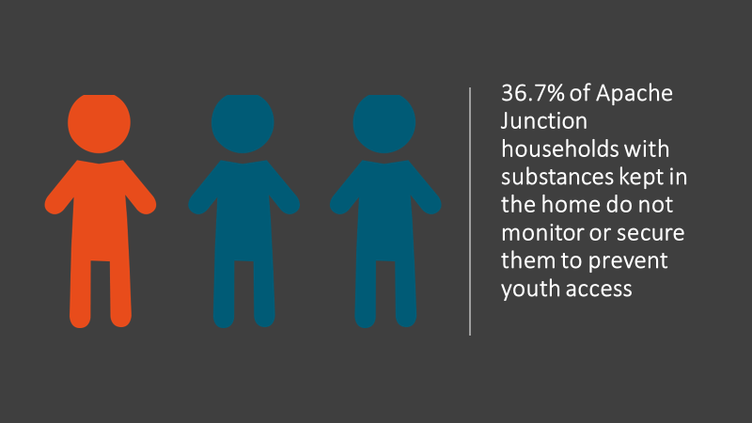

Slide 22
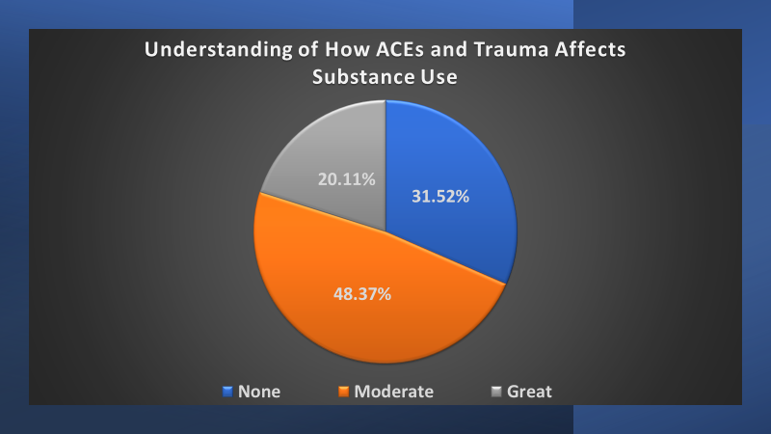

Slide 23
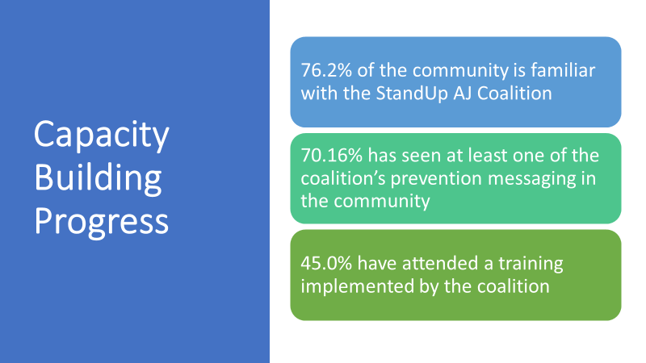

Slide 24
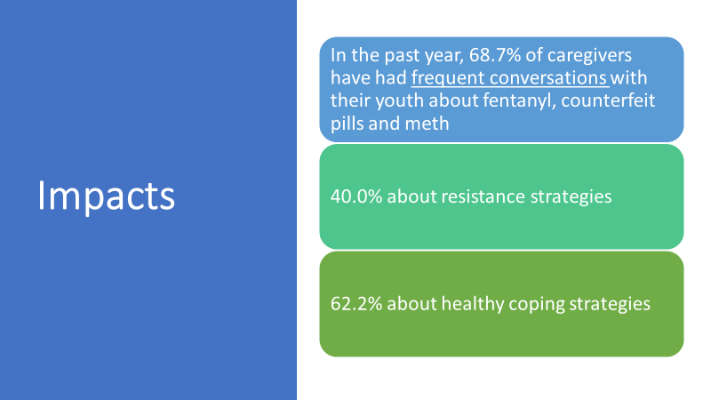

Slide 25
You can also split your content
SUSTAINABILITY
DATA
All school participation in the Arizona Youth Survey
COMMUNITY READINESS
We went from no awareness to action. Narcan distribution and education are now needs. We are responding!
FUNDING
CONFIRMED WE ARE A DRUG FREE COMMUNITIES AWARD RECIPIENT. 5 YEARS OF NON COMPETITIVE FUNDING!!!

Slide 26
Thanks!
ANY QUESTIONS?
You can find us at:
Bernadette_Coggins@tempe.gov
joronda@gmail.com
director@standupaj.org

