Slide 1
Proposition 207
Smart and Safe Arizona Act
Justice Reinvestment Program

Slide 2
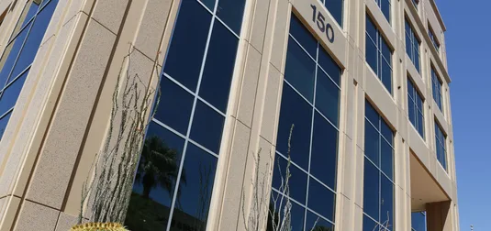
Quick Facts
Passed by Arizona voters November 2020
Allows legalization, taxation, and recreational use of marijuana for adults 21 and over
Justice Reinvestment Fund monies awarded to Local Health Departments and ADHS for justice reinvestment programs

Slide 3
A.R.S. 36-2863.
Justice reinvestment fund; exemption; distribution; definition¹
C. On or before June 30 and December 31 of each year, the state treasurer shall transfer all monies in the justice reinvestment fund in excess of the amounts paid pursuant to subsection B of this section as follows:
1. Thirty-five percent to county public health departments, in proportion to the population of each county according to the most recent United States decennial census, for the purpose of providing justice reinvestment programs or distributing grants to qualified nonprofit organizations to provide justice reinvestment programs in that county.
2. Thirty-five percent to the department for the purpose of distributing grants to qualified nonprofit organizations that provide justice reinvestment programs in this state.
3. Thirty percent to the department for the purpose of addressing important public health issues that affect this state.
1. A.R.S. § 36-2863 (C)(1-3)

Slide 4
Justice Reinvestment Programs ¹
Justice Reinvestment Programs means initiatives or programs that focus on any of the following:
Public and behavioral health, including evidence-based and evidence-informed substance use prevention and treatment and substance use early intervention services.
Restorative justice, jail diversion, workforce development, industry-specific technical assistance or mentoring services for economically disadvantaged persons in communities disproportionately impacted by high rates of arrest and incarceration.
Addressing the underlying causes of crime, reducing drug-related arrests and reducing the prison population in this state.
Creating or developing technology and programs to assist with the restoration of civil rights and the expungement of criminal records.
1. A.R.S. § 36-2863 (G)(1-4)

Slide 5
Justice Reinvestment Program planning
Identified Social Equity Licensure Program eligibility zip codes
Hired a coordinator
Met with stakeholders from:
  Youth and foster serving organizations
  Legal aid groups and the ACLU of Arizona
  Latino Coalition for Community Leadership (Colorado WAGEES Program)
  Substance Treatment providers (BCBS)
  African American Community
  Re-entry organizations
Notes:
Recognized that public health professionals criminal justice was not an area we have much expertise and depth

Slide 6
Next Steps
Data gathering
Funding Landscape
Community Input
Program Evaluation
Identify communities experiencing high rates of arrest and incarceration
Understand the current funding landscape in Arizona
Planning to hold a series of statewide community listening sessions
Develop a robust program evaluation process
Notes:
ADHS is currently engaged in a number of activities to ensure that Justice Reinvestment grants serve those impacted by arrest and incarceration and have the intended impact. We are utilizing a data–driven, community-centered process to inform the development of the Justice Reinvestment program consisting of:
Data gathering that identifies communities experiencing high rates of arrest and incarceration throughout Arizona. This will include examining disparities by geographic, racial, ethnic, income, or other factors as well as a literature review on the root causes of arrest and incarceration in Arizona. LMA will obtain and review the published reports on crime and incarceration from selected
state and local criminal justice agencies as appropriate and according to the ADHS timeline. Reports from The Department of Public Safety (AZDPS), the Arizona Administrative
Office of the Courts (AOC), the Arizona Department of Corrections (ADOC), and the Arizona Criminal Justice Commission (ACJC) will be reviewed. Also, the larger counties, such as
Maricopa, Pima, Pinal, and Coconino have published criminal justice data reports on jail counts, community supervision rates, and possibly other county justice programs that could be relevant to our analysis and to the community listening sessions.
Understanding the current funding landscape in Arizona in regards to the four definational areas of Justice Reinvestment programming outlined in the statute, and above. particularly around substance use prevention and to a less extent treatment
Planning to hold a series of statewide community listening sessions to learn from community members and stakeholders impacted by arrest and incarceration about their definitions and priorities around Justice Reinvestment.
Developing a robust program evaluation process to ensure that funded projects serve the intended communities and create the intended impact.

Slide 7
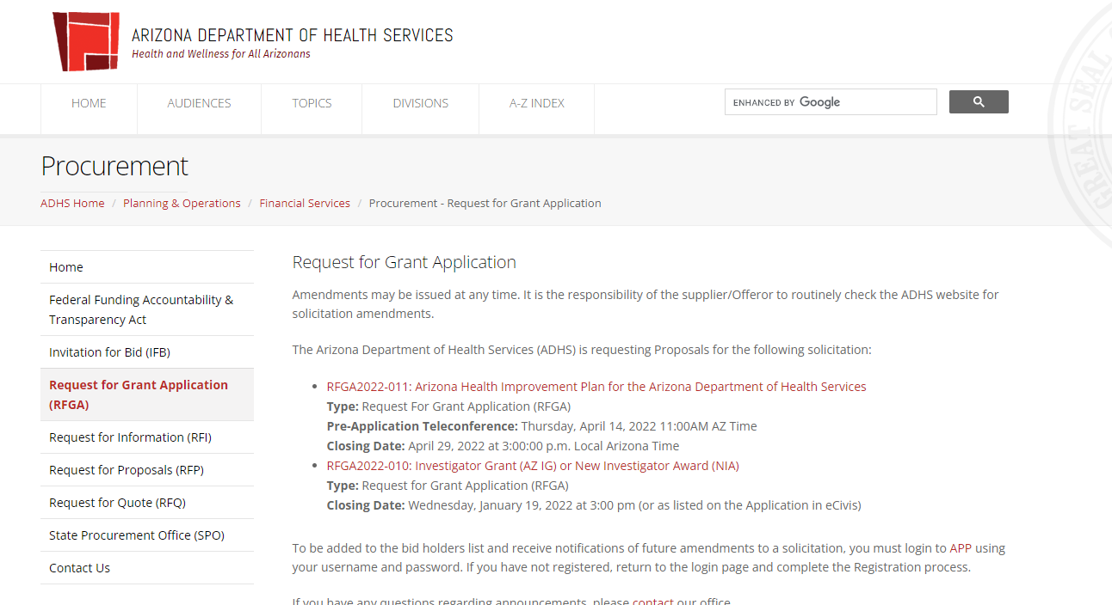
Looking Forward
Develop & release a Request for Grant Application (RFGA)
*Announcement made public on our website
Notes:
ADHS will utilize this information to develop and release a Request for Grant Application (RFGA) solicitation. Qualified nonprofits will be able to apply for Justice Reinvestment Funds and offer appropriate programming to communities. All grantees will participate in an ADHS led evaluation process.

Slide 8
We want to hear your voice!
Ways to engage:
Are you be willing to be contacted by our external evaluator?
Host a listening session?
Notes:
Data on funding streams

Slide 9
Contact Information
Siman Qaasim
Health Equity Administrator
Office of Health Equity
siman.qaasim@azdhs.gov
Office: (602) 542-4666
Mobile: (602) 376-0982
Meghanne Bearden
SDOH & Justice Reinvestment Manager
Office of Health Equity
meghanne.bearden@azdhs.gov
Mobile: (480) 708-5607

