Slide 1

An Update on
Arizona Overdose Trends
May 3, 2023
Sheila Sjolander, Deputy Director
Public Health Services

Slide 2
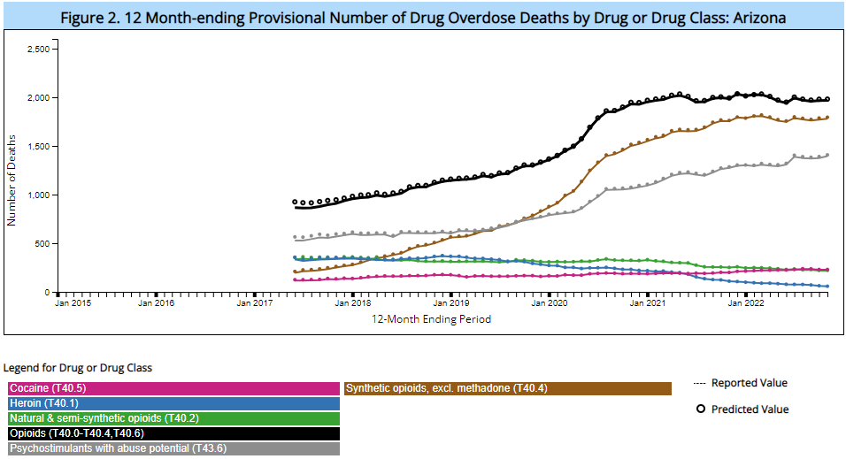
CDC 12 Month-ending Provisional Drug Overdoses
As of April 2023:
1,968 deaths involving opioids
1,396 deaths involving psychostimulants
In prior 12 months
Total Number of Reported Overdose Deaths in Past 12 Months in Arizona
Nov 2020: 2,649
Nov 2021: 2,721
Nov 2022: 2,739
Source: https://www.cdc.gov/nchs/nvss/vsrr/drug-overdose-data.htm (4/27/2023)
Notes:
https://www.cdc.gov/nchs/nvss/vsrr/drug-overdose-data.htm;
NOTES: Reported provisional counts for 12-month ending periods are the number of deaths received and processed for the 12-month period ending in the month indicated. Provisional counts may not include all deaths that occurred during a given time period. Therefore, they should not be considered comparable with final data and are subject to change. Predicted provisional counts represent estimates of the number of deaths adjusted for incomplete reporting (see Technical Notes). Deaths in this report are classified by the reporting jurisdiction in which the death occurred and include foreign residents. Number of deaths in this report may not match final reported data, which are reported by the jurisdiction of residence and are limited to US residents. Jurisdictions are selected for inclusion in this dashboard if they have met the original three measures of data quality (a) overall percent completeness of reporting (≥ 90%), (b) the percentage of records pending investigation (≤ 1%), and (c) the percentage of overdose deaths with drug specified (≤ 90%) for the size most recent 12-month ending periods as opposed to for the entire period starting with January, 2015. For jurisdictions not meeting quality measures for all periods starting with January 2015, predicted values are shown for all data points that meet percent completeness and drug specificity thresholds with reported values only shown for months where all three data quality measures were met. As a result, estimates are shown for selected reporting periods before the most recent 6 months and there may be gaps in the trends. Drug overdose deaths are identified using ICD–10 underlying cause of death codes: X40–X44, X60–X64, X85, and Y10–Y14. Drug overdose deaths involving selected drug categories are identified by ICD–10 multiple cause-of-death (MCOD) codes: heroin, T40.1; natural and semisynthetic opioids, including drugs such as oxycodone, hydrocodone, and morphine, T40.2; methadone, T40.3; synthetic opioids, including drugs such as fentanyl and tramadol and excluding methadone, T40.4; cocaine, T40.5; and psychostimulants with abuse potential, including drugs such as methamphetamine, T43.6. Opioid overdose deaths are identified by the presence of any of the following MCOD codes: opium, T40.0; heroin, T40.1; natural and synthetic, and synthetic opioids, including methadone (T40.2–T40.4); and natural and semi-synthetic opioids, including methadone (T40.2–T40.3). These categories can be selected in the 'Select specific drugs or drug classes' drop-down menu above the chart. Categories are not mutually exclusive because deaths may involve more than one drug. Among deaths with an underlying cause of drug overdose, the percentage with at least one drug or drug class specified was determined using MCOD codes in the range of T36–T50.8.

Slide 3
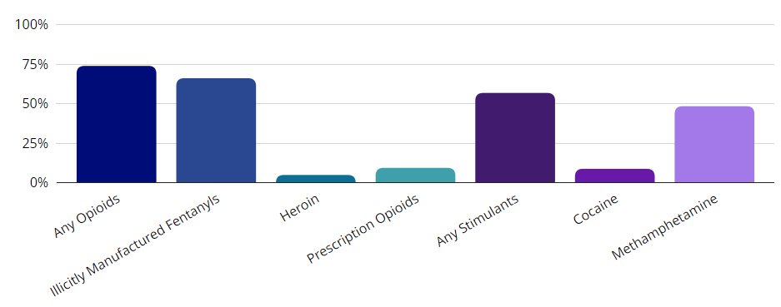
Of all drug overdose deaths in 2021, 74% involved at least one opioid and 57% involved at least one stimulant.
Source: https://www.cdc.gov/drugoverdose/fatal/dashboard/index.html (2021)

Slide 4
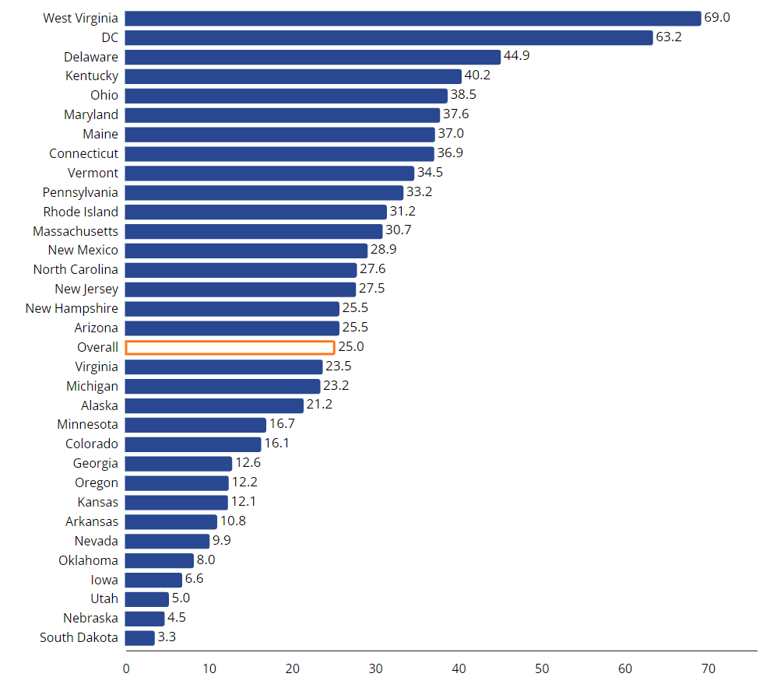
Rate of Overdose Deaths Involving Illicitly Manufactured Fentanyls by State in 2021 (32 jurisdictions)
Source: https://www.cdc.gov/drugoverdose/fatal/dashboard/index.html, accessed 4/27/23

Slide 5
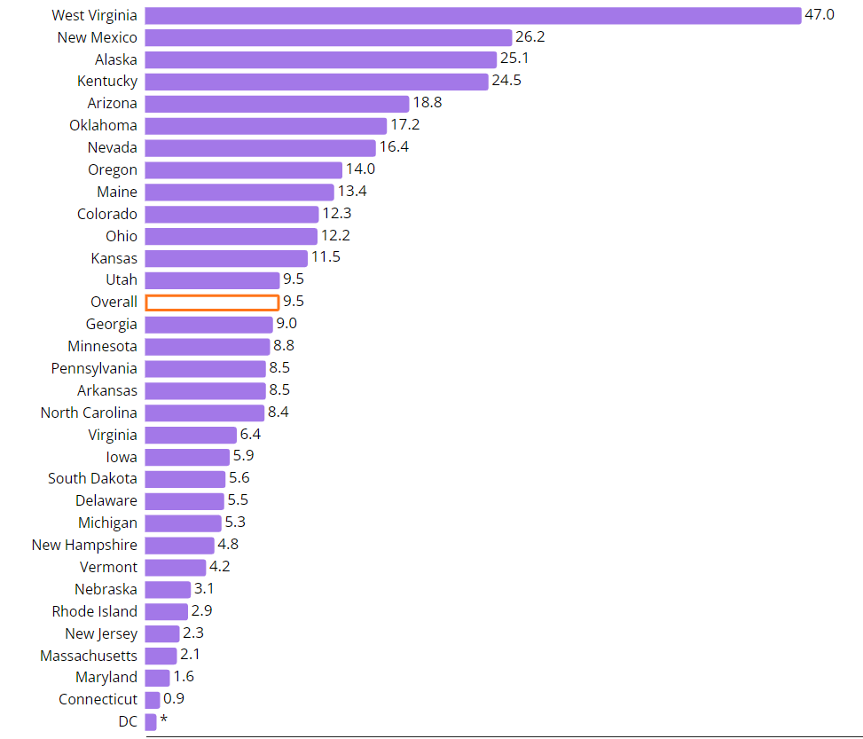
Rate of Overdose Deaths Involving Methamphetamine by State in 2021 (32 jurisdictions)
Source: https://www.cdc.gov/drugoverdose/fatal/dashboard/index.html, accessed 4/27/23

Slide 6
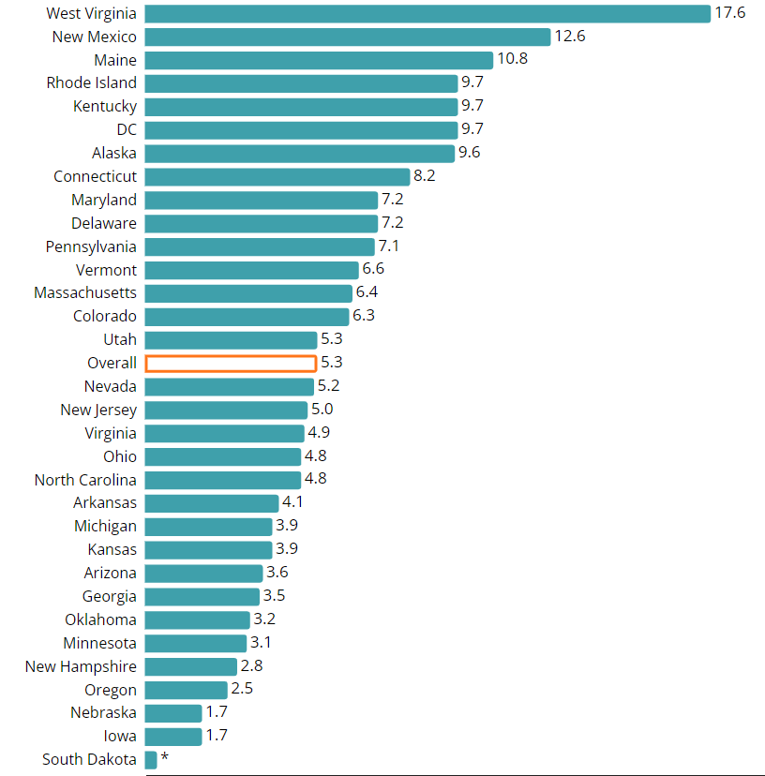
Rate of Overdose Deaths Involving Prescription Opioids by State in 2021 (32 jurisdictions)
Source: https://www.cdc.gov/drugoverdose/fatal/dashboard/index.html, accessed 4/27/23

Slide 7
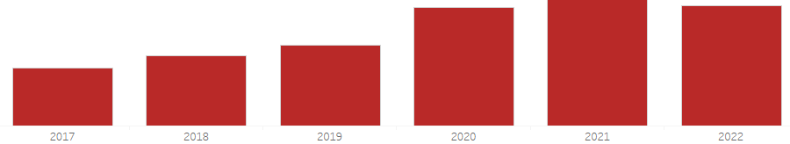
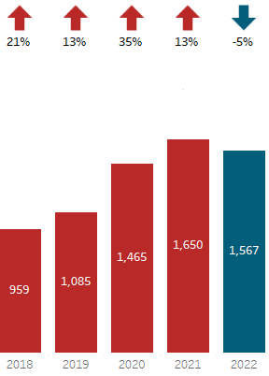
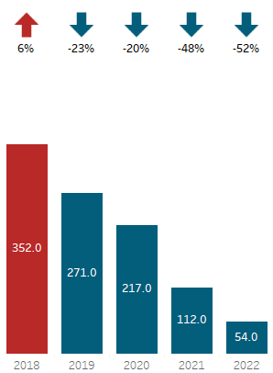
Approximately 5 Arizonans a day died from opioids in 2022
923
1,116
1,294
1,886
2,015
1,926
In 2022, 81% of opioid deaths involved multiple drugs;
In 2022, 3% of opioid deaths involved Heroin;
Notes:
*Data Source: Death Certificates (Jan 2017- Dec 2022).
Only opioid deaths among Arizona residents are displayed on the graph. In 2022, Arizona has had 1,847 opioid deaths. Please note that data for 2022 is provisional and subject to change.
Opioid deaths involving Rx/Synthetic drugs and polysubstance continue to increase, while opioid deaths involving heroin are decreasing.
Date updated: 04/26/2023

Slide 8
The total number of opioid overdose deaths may be leveling off
Data Source: Arizona Vital Statistics, Death Certificates
Notes:
*Data Source: Death Certificates
**Please note that data for 2022 is provisional and subject to change. Only opioid deaths among Arizona residents are displayed on the graph.
Date updated: 03/13/2023
As of 4/26/23: 189 opioid overdose deaths have been recorded

Slide 9
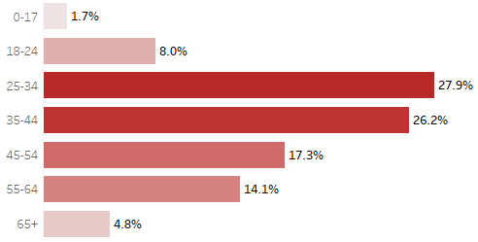
In 2022, two-thirds of opioid deaths were among people aged 25-54.
The highest rate of fatalities occurred among 35-44 year-olds (56.2 per 100,000 population).
Data Source: Arizona Vital Statistics, Death Certificates
Notes:
*Data Source: Death Certificates, Jan-Dec 2022
**Please note that data for 2022 is provisional and subject to change. Only opioid deaths among Arizona residents are displayed on the graph.
Updated on 04/26/2023
76% of fatalities are among men

Slide 10
Among children ages 0-17 in 2022 there were…
138 Non-fatal Opioid Overdoses
33 Fatal Opioid Overdoses
Data Sources:
Non-Fatal Overdoses (Arizona - Medical Electronic Disease Surveillance Intelligence System (MEDSIS))
Fatal Overdoses (Arizona Vital Statistics, Death Certificates)
Notes:
Updated 4/26/23

Slide 11
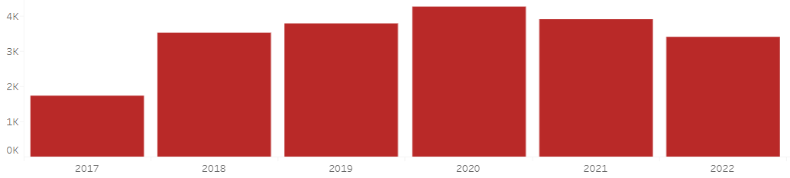
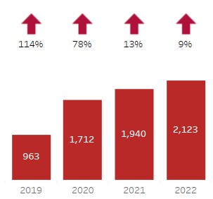
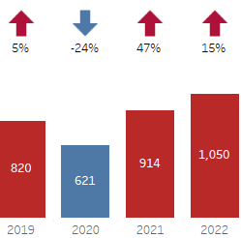
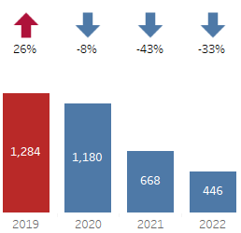
Approximately 9 Arizonans a day had a non-fatal opioid overdose in 2022
Verified non-fatal opioid overdose events in Arizona by Year, All Years
1,736
3,540
3,782
4,270
3,916
3,313
1,596
3,224
3,497
3,988
3,556
ADHS Opioid Dashboard: https://www.azdhs.gov/opioid/index.php#dashboards-nonfatal-overdoses
In 2022, 64% of non-fatal opioid events have involved fentanyl;
level trend
In 2022, 32% of non-fatal opioid events have involved Meth/Amphetamine; increasing trend
In 2022, 10% of non-fatal opioid events have involved oxycodone;
decreasing trend
Year over year percent increase
Notes:
*Data Source: MEDSIS (Jun 2017- Dec 2022)
**Please note that data for 2021 and 2022 is provisional and subject to change.
Date updated: 04/26/2023

Slide 12
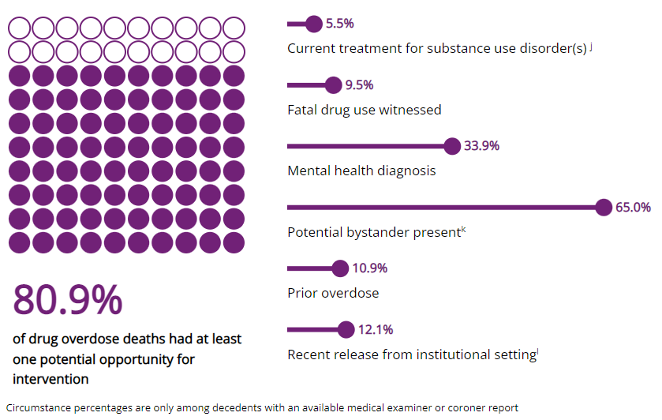
Potential opportunities for intervention (all unintentional drug overdoses in Arizona) include linkages to care or life-saving actions
Data Source: SUDORS Dashboard - https://www.cdc.gov/drugoverdose/fatal/dashboard/ (2021)

Slide 13
The number of opioid prescriptions dispensed in Arizona has decreased from 2018 to 2023.
Data Source: Controlled Substance Prescription Monitoring Program (CSPMP).
Notes: Rolling average calculated as average number of events in previous 12 months.
Notes:
Data Source: Controlled Substance Prescription Monitoring Program (CSPMP). For more information on CSPMP, please visit: https://pharmacypmp.az.gov/
ADHS Opioid Prescriptions Dashboard: https://www.azdhs.gov/opioid/#dashboards-prescriptions
Updated on 03/14/2023

Slide 14
The number of naloxone dispensed by pharmacies in Arizona has increased significantly since 2017.
Nov 11, 2017
Director of ADHS issued standing order that allows any Arizona licensed pharmacist to dispense naloxone without a prescription
Data Source: Controlled Substance Prescription Monitoring Program (CSPMP).
Notes: Rolling average calculated as average number of events in previous 12 months.
Notes:
Total of 54,863 in 2022.
Updated on 03/10/2023

Slide 15
For More Information
azdhs.gov/opioid
azopioid@azdhs.gov
Sheila Sjolander, MSW
Deputy Director
sheila.sjolander@azdhs.gov

