Slide 1




Myriah Mhoon, CEO
Amy Scanlon, Outreach Director

Slide 2



Mission: Helping to eliminate domestic and sexual violence through support services,
education and expertise.
Vision: Creating an Arizona where all live free of domestic and sexual violence.
Values: Compassion. Resilience. Equity. Community.

Slide 3




Residential
Outreach
Training
Prevention
Hope's Closet

Slide 4

NLC’s 2021 Impact
1,062 Individuals served throughout NLC programming
27,849 Meals served to individuals in shelter
9,503 Hours of advocacy offered
17,950 Safe bed nights

Slide 5

Sunshine Healing Services

Slide 6

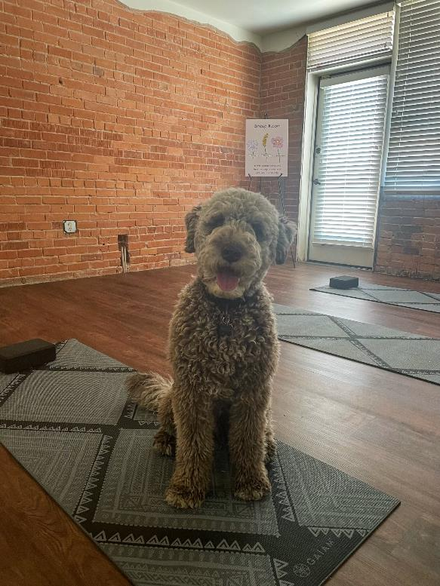

Slide 7
Sexual Violence: Any sexual activity that occurs without consent of everyone involved. This includes sexual activities involving physical contact, non-physical, sexual harassment, and sex trafficking
National Sexual Violence
The average age at the time of reporting is 52 years old
Every 68 seconds a person in the US is sexually assaulted
Offenders are usually known by their victim
Of 1,000 sexual assaults only 310 are reported to LE (2 out of 3)
Over 90% of people that have been HT have been sexually assaulted in the past
Rape Crisis Center: A community based agency that works to help victims of sexual violence. A RCC provides a number of services, such as victim advocacy, crisis hotline, outreach and education

Slide 8
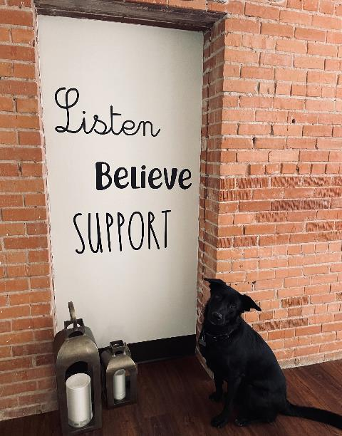
Healing Services
We serve primary & secondary victims of sexual
violence over the age of 18
Survivors can receive services without having to report
to law enforcement. All services are voluntary
Services are available to survivors at any point during
their lifespan
Survivors are always informed of system based responses
Sexual Violence Healing Center + Rape Crisis Center +
Non Crisis Support

Slide 9
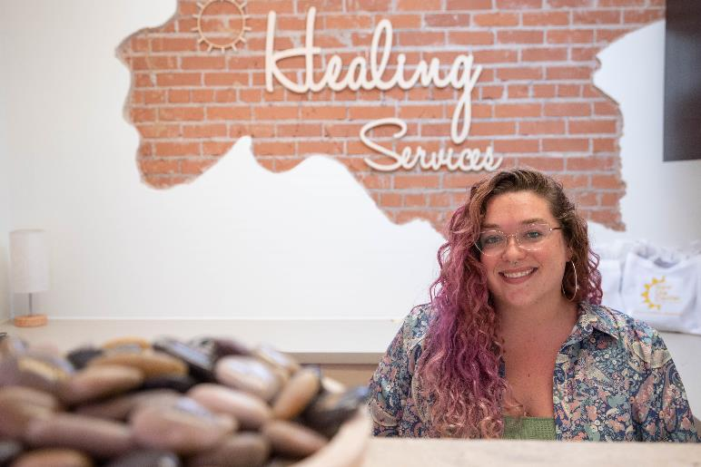
Healing Services
Advocacy & Case Management
Groups
Trauma Treatment
Law Enforcement Reporting & Coordination
Medical and Court Accompaniment
Holistic Healing Options

Slide 10
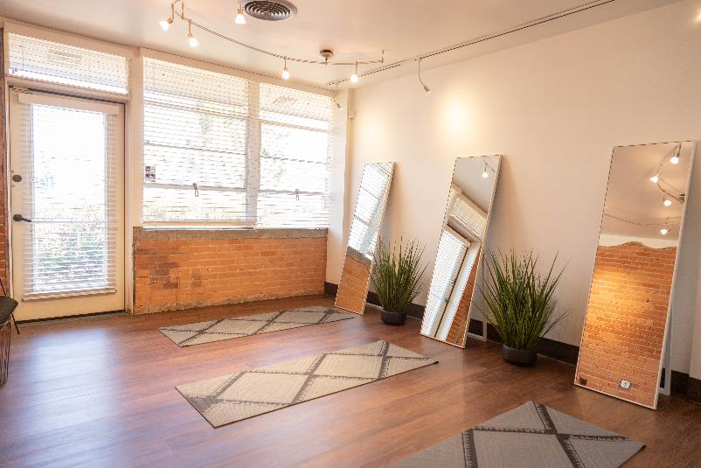
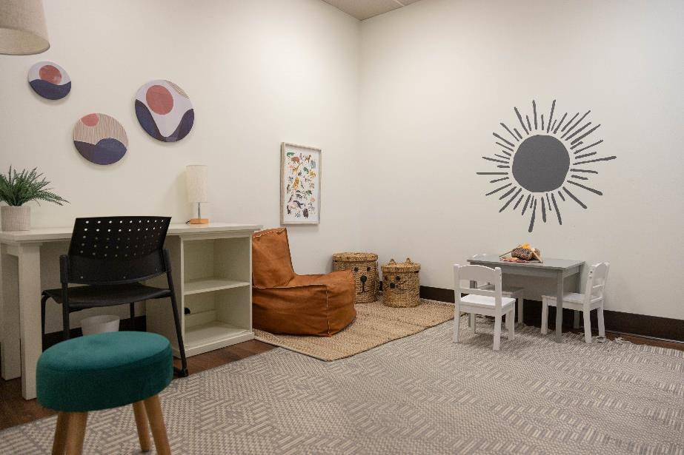
Programs
Sexual Violence Healing Services
Human Trafficking Program
Sexual Assault Investigation Training Program
Kaity’s Way Prevention Program.

Slide 11
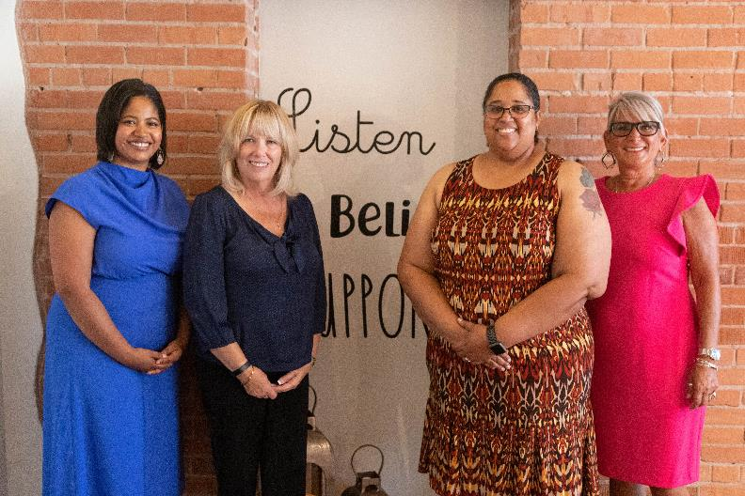
A Multidisciplinary Response
West Valley Sexual Assault Response Team
Community Partnerships with:
All Family Advocacy Center’s
Law Enforcement, Maricopa County Attorney’s Office, City of Phoenix

Slide 12
Call to Action:
Continue to advocate for state dollars for sexual violence service’s
Help us educate the community about RCC & SHS
Come take a tour!
Visit our website at newlifectr.org

Slide 13
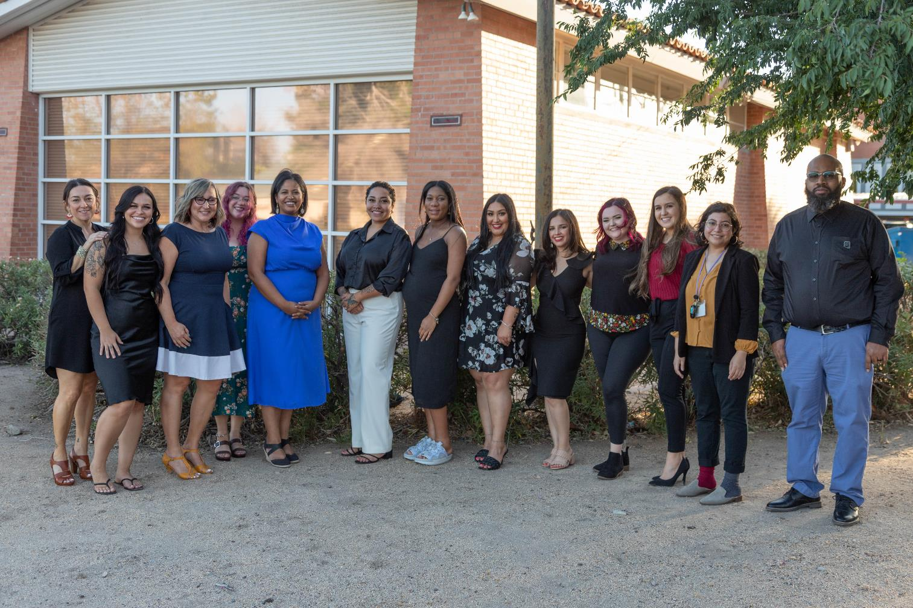
Call to Action:
Continue to advocate for state dollars for sexual violence service’s
Help us educate the community about RCC & SHS
Come take a tour!
Visit our website at newlifectr.org

Slide 14
Thank you!
Myriah Mhoon, CEO
mmhoon@newlifectr.org
Amy Scanlon, Outreach Director
ascanlon@newlifectr.org
newlifectr.org

