Slide 1


Strengthening Civic Health in Arizona
Governor’s Commission on Service & Volunteerism
May 8, 2024
Notes:
Thanks to CFA, we understand that Arizonans desire meaningful civic engagement that effectively solves problems and builds a democracy that serves everyone.
This shared public value is the driving force propelling all our shared public values forward.
To achieve any of them, strong civic engagement and leadership aren’t just desirable; they’re indispensable.
In today’s fast-changing media and information landscape, a community connected by active civic participation is healthier and can serve as a stronghold against divisive rhetoric and polarization.

Slide 2
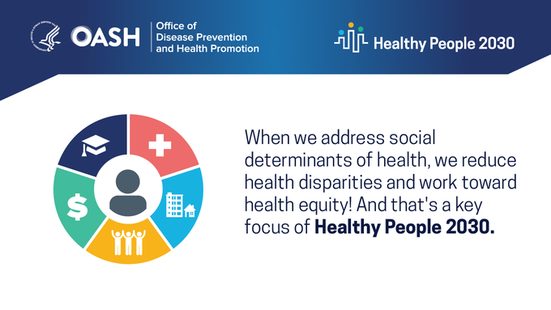
Healthy Democracy, Healthier People
Growing movement, growing body of research
Notes:
So, let’s look at that concept – that a healthy democracy contributes to healthier people.
There is a growing movement and body of research that shows the more civically engaged we are, the healthier we and our communities are.
The importance of civic participation to health has been made apparent by the U.S. Department of Health and Human Services.
In 2023, the country’s data-driven goals to improve health and well-being – Healthy People 2030 – elevated civic participation to a core objective.
If we are to continue to improve health, we must increase the proportion of voters who participate in our democratic process.

Slide 3

“We’ve learned that belonging & civic muscle can significantly impact an individual’s & a community’s resilience & capacity to thrive.”
Rear Admiral Paul Reed
Deputy Assistant Secretary for Health
Director, Office of Disease Prevention & Health Promotion
Notes:
“We’ve learned that belonging and civic muscle can significantly impact an individual’s and a community’s resilience and capacity to thrive,” says Rear Admiral Paul Reed, Deputy Assistant Secretary for Health and the Director at the Office of Disease Prevention and Health Promotion.
“Voting is one way for individuals to flex this civic muscle and help their communities determine a shared direction and shape a common vision.”

Slide 4





Healthy Democracy, Healthier People
Growing movement, growing body of research
Notes:
It is a message that is gaining ground in the health sector.
The National Academies of Sciences, Engineering, and Medicine, as well as the , have added their platforms to growing the understanding of the relationship between civic participation and positive health outcomes.
Public health organizations have also leveraged their voice in this movement.
The has lifted civic and voter participation to address determinants of health and make progress on health disparities.
Voting and Health: Expanding Opportunities for Inclusion https://www.nationalacademies.org/event/09-15-2021/webinar-voting-and-health-expanding-opportunities-for-inclusion
Another question for patients: Are you registered to vote? https://www.ama-assn.org/delivering-care/health-equity/another-question-patients-are-you-registered-vote
Advancing Health Equity through Protecting and Promoting Access to Voting https://www.apha.org/Policies-and-Advocacy/Public-Health-Policy-Statements/Policy-Database/2023/01/18/Access-to-Voting

Slide 5
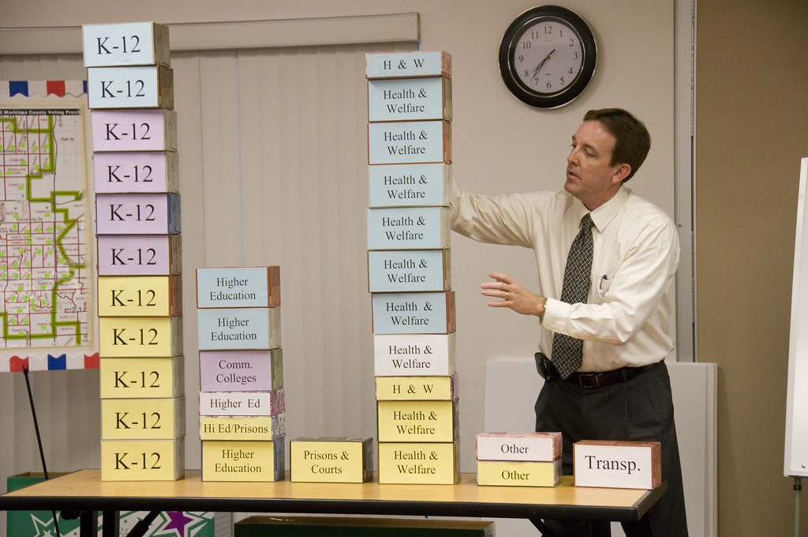
Why It Matters
Health Policy Outcomes
Notes:
Those voting outcomes also have direct policy implications that affect our health.
Forty-four percent of Arizona’s General Fund is comprised of federal funds that support health-oriented programs like health insurance for low-income adults and children, nutritional and cash assistance, housing vouchers and loans, school grants and financial aid, and transportation construction.
Joint Legislative Budget Committee staff, Fiscal Year 2024 Appropriations Report https://www.azjlbc.gov/24AR/428.pdf

Slide 6
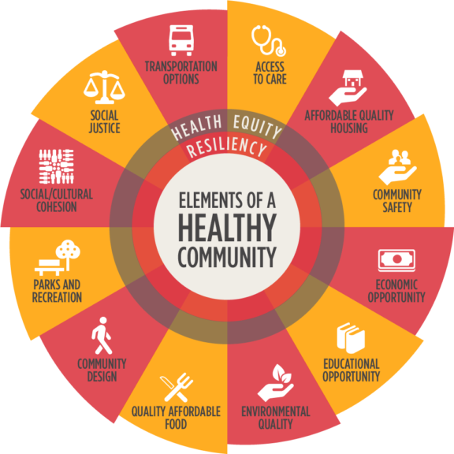
Why It Matters
Zip Code, not Genetic Code, determines life expectancy
Notes:
These broader health indicators, referred to by Vitalyst Health Foundation as the “Elements of a Healthy Community,” often showcase that a person’s zip code, not their genetic code, determines life expectancy.
This intersection of civic engagement and health link voting with other “civic health” measures that also improve the health of people and communities.
Things like belonging and social cohesion have evidence on self-reported health and well-being.

Slide 7
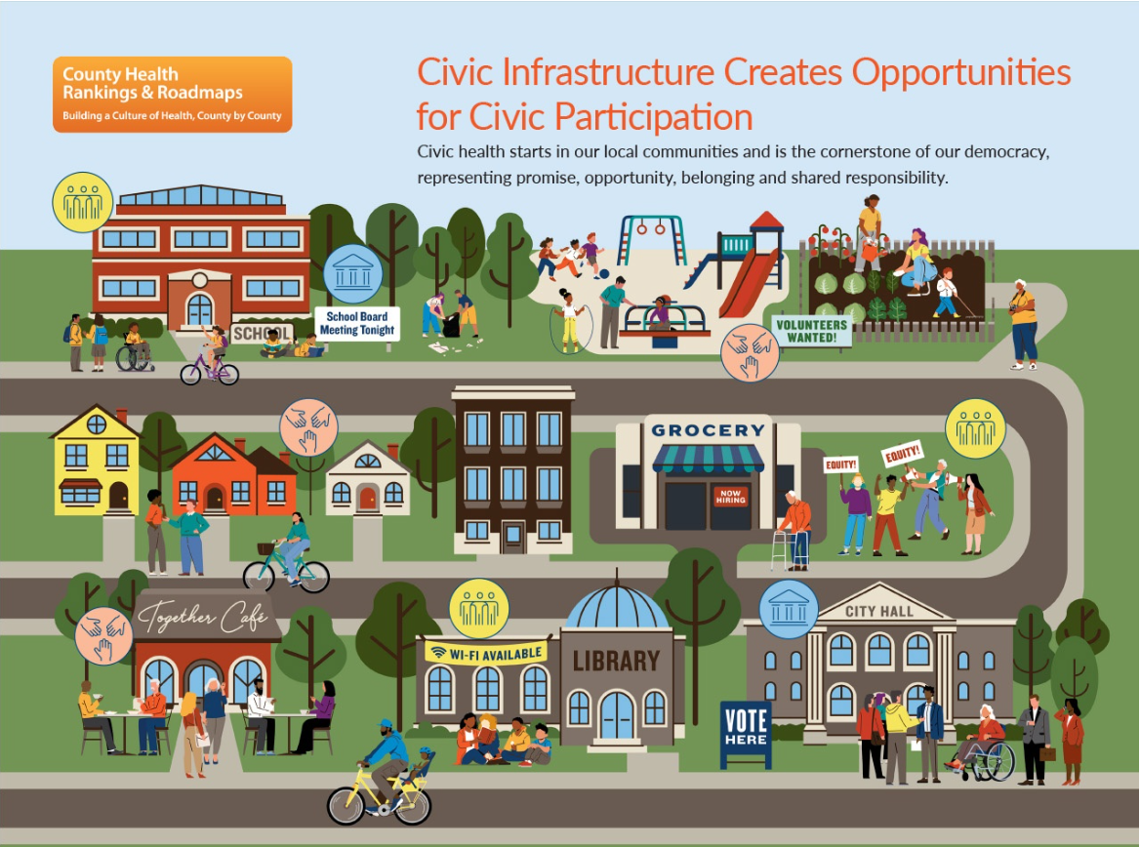
Notes:
This concept of civic health – how people and communities have the capacity to engage and unify to resolve problems – is one measured through County Health Rankings & Roadmaps.
This data again makes a “connection between civic health and thriving people and places.”

Slide 8
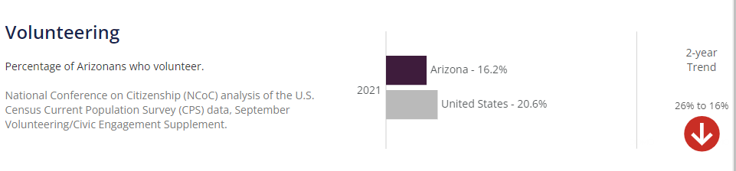
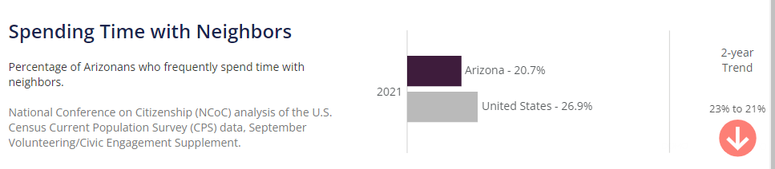
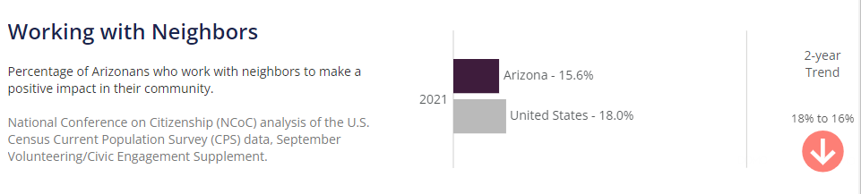
Why It Matters, Still
Arizona’s Civic Health
Notes:
Why does this matter?
Local data records the percentage of Arizonans who volunteer, belong to groups, or spend time or work with neighbors, often fall below national statistics.
The highest data point shows less than half of Arizonans – 48.5% - contribute to charitable organizations.
These efforts represent opportunities for the community to engage in civic life toward the common good.
They are examples of activities that build social and cultural cohesion, and ultimately civic health.

Slide 9
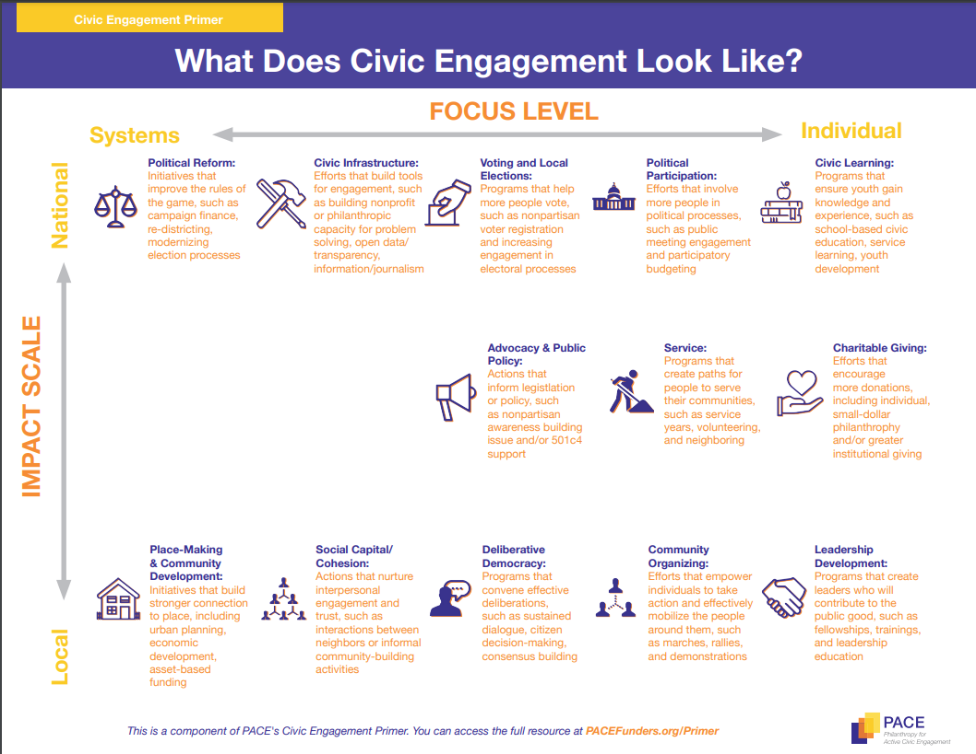
Notes:
These efforts represent opportunities for the community to engage in civic life toward the common good.
They are examples of activities that build social and cultural cohesion, and ultimately civic health.

Slide 10
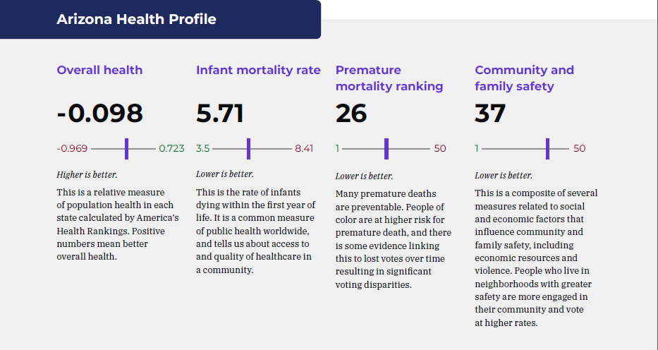
Healthy People, Healthy Democracy
Notes:
To show the importance of strengthening civic health in Arizona, Vitalyst published a report to showcase the intersection of civic engagement and health.
In partnership with the Healthy Democracy Healthy People Initiative, the report recognizes that civic participation and voting are important for health.
As reflected in the report, “in 2021, a coalition of public health organizations analyzed voting structures and public health outcomes across the U.S.
The coalition developed the Health & Democracy Index to compare 12 public health indicators such as voter turnout and voting policies in each state.
The Health & Democracy Index provides a shared health equity analysis of voting policy and serves as a tool to strengthen civic and voting participation.
The Health & Democracy Index includes health measures only if there is an evidence-based link between the measure and civic engagement.”

Slide 11
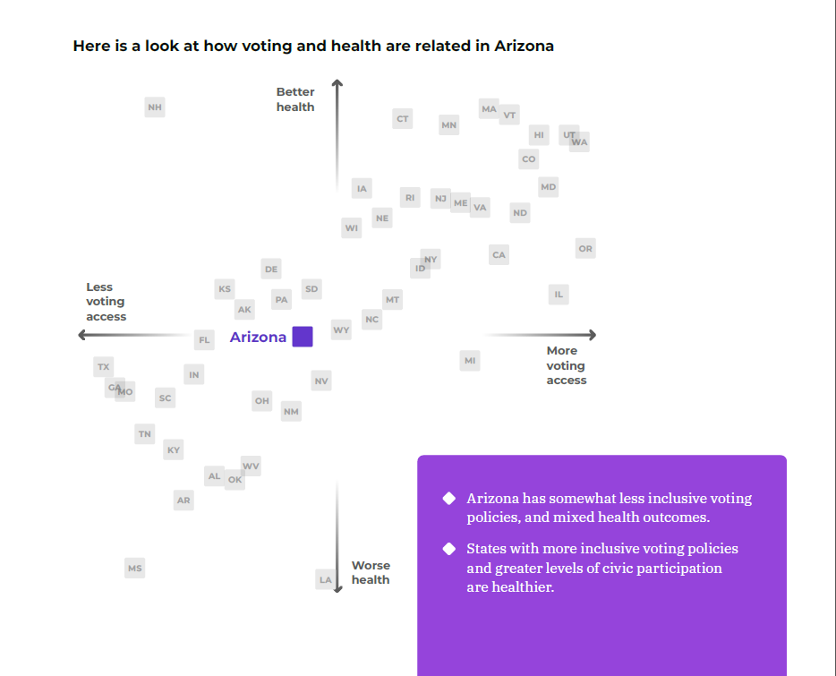
Cost of Voting Index
Notes:
That index compares those indicators and voter turnout to the Cost of Voting Index, or COVI, which refers to the time and effort associated with casting a vote, and which may reflect the overall climate in a state.
The elections-related systems COVI includes registration deadlines; registration restrictions, such as no online voter registration; registration drive restrictions, such as training required by state; pre-registration for 16- and 17-year-olds; automatic voter registration; voting inconvenience, such as excuse required for vote absentee; voter ID laws; poll hours; and early voting.
The Index shows how voting can shape individual and community health, and how voting barriers correlate with worse health outcomes.

Slide 12
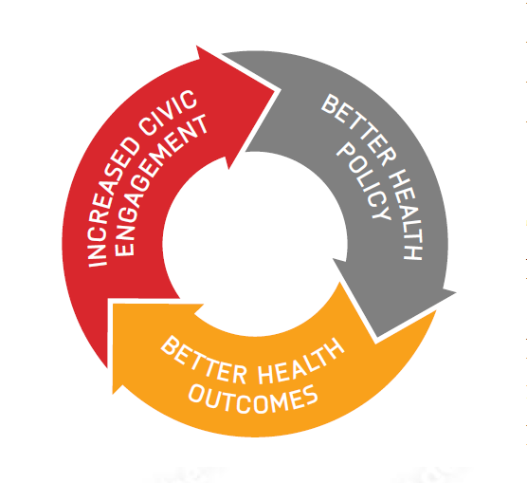
Civic Health Matters for Arizona
Democratic processes that are inclusive and robust are vital to creating the opportunity for everyone to be healthy.
Notes:
It is just one more tool in the growing movement and body of research that shows the health and well-being of people and communities depend on the active participation and engagement of residents.
It’s also why Vitalyst has prioritized its approach to strengthening civic health, including its support of: Arizona Town Hall for effective deliberation and consensus building; Arizona Gives Day to inspire charitable giving and more donations to local nonprofits; place-based community development through the Live Well AZ Incubator, and informing public policy and nonpartisan awareness building.
Democratic processes that are inclusive and robust are vital to creating the opportunity for everyone to be healthy. Civic health matters for Arizona.

Slide 13


